Slide 1
Ethics and Professional Responsibility
Non-Euclidean Game - Lights Out
Project Members: Tasman Grinnell, Ben Johnson, Josh Deaton
Cory Roth, Zach Rapoza, Spencer Thiele, Lincoln Kness
Advisor: Dr. Joseph Zambreno
Client: Josh Deaton
| sdmay25-37
Notes:
Introduce Everyone

Slide 2
Project Overview
This project aims to:
Create a Non-Euclidean 2-dimensional game/rendering engine
Design and develop a game to showcase the engine
| Lights Out
| Non-Euclidean Game
Ethics and Professional Responsibility | 1
Notes:
Tasman

Slide 3
Project Deliverables
The final deliverables are:
A working game/rendering engine featuring Non-Euclidean Geometry
A finished and polished videogame matching:
Design Requirements
Functional Requirements
| Lights Out
| Non-Euclidean Game
Ethics and Professional Responsibility | 2
Notes:
Tasman

Slide 4
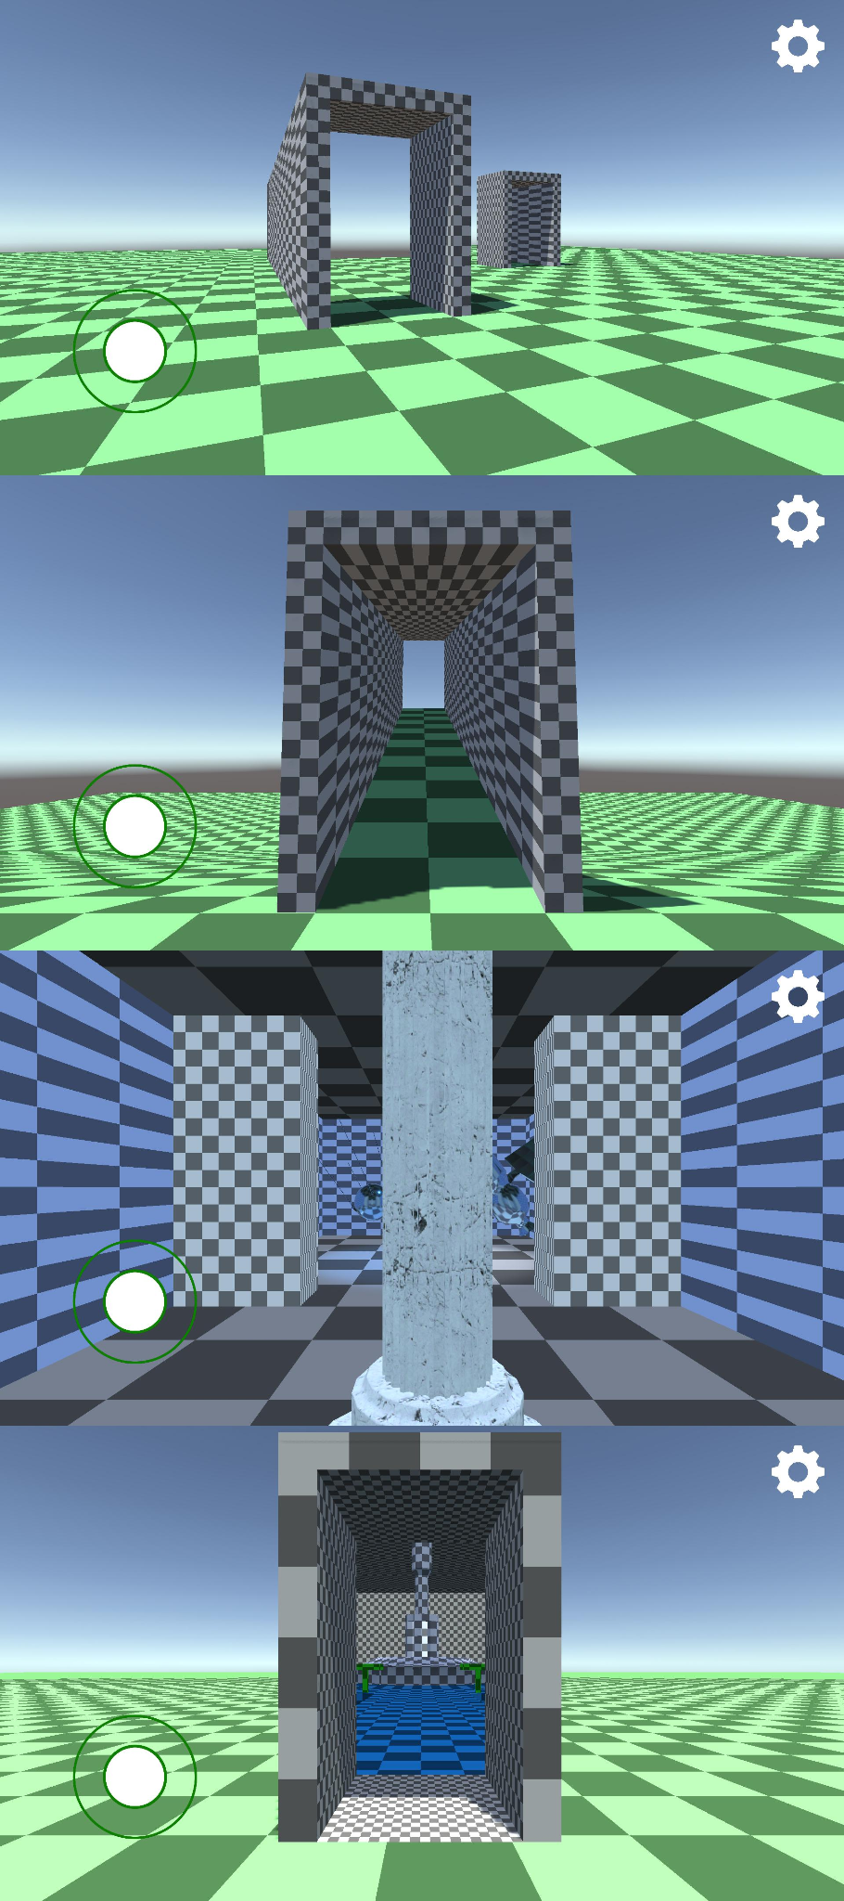
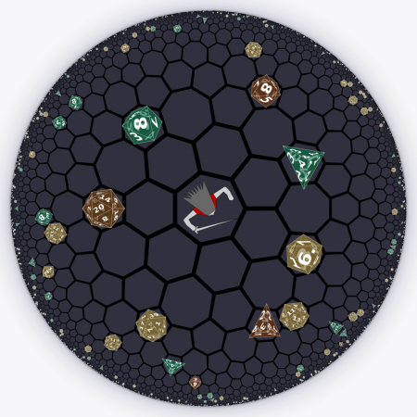
Problem Statement
Current State of Non-Euclidean games:
Limits in rendering techniques
Primary focus in experimentation or research
Therefore, our goal is to build a Non-Euclidean rendering engine and build a entertaining game on top of the engine.
| Lights Out
| Non-Euclidean Game
Ethics and Professional Responsibility | 3
Notes:
Zach:
–improve
–mention game problem statement

Slide 5
Financial Responsibility - Area Performing Well
Relevance
Software projects often bloat budgets
Sets unrealistic expectations for personnel hours.
Our Teams Approach
Avoiding services that explicitly require payments (e.g. Unity Version Control)
Use of Open Source Resources and Code Bases
Why This Upholds Ethics
Use of low cost technology and resources allow for the budget of project to be well maintained
| Lights Out
| Non-Euclidean Game
Ethics and Professional Responsibility | 4
Notes:
Zach:
–improve
–mention game problem statement

Slide 6
Social Responsibility - Underperforming Area
Relevance
Project has low impact on improving the social environment
Main outcome is personal enjoyment
Teams Approach
Design of the project was undergone at the beginning of the semester
Was not a focus in initial design
How we will change this approach
We will focus part of changing our design to spread awareness of environmental injustices.
| Lights Out
| Non-Euclidean Game
Ethics and Professional Responsibility | 5
Notes:
Zach:
–improve
–mention game problem statement

Slide 7
Broader Context Area - Four Principle Chart
Nonmaleficence - Avoiding Harm
Project Goal: Explore interesting ideas and create an enjoyable product
Avoiding Harm is morally necessary as a student-proposed project
Other principles are not applicable
| Lights Out
| Non-Euclidean Game
Ethics and Professional Responsibility | 6
Notes:
Zach:
–improve
–mention game problem statement

Slide 8
Ethical Issues
Lack of Compensation for Developers
Potential for infighting due to lack of HR protections
Difficult moral decisions for acquiring assets
| Lights Out
| Non-Euclidean Game
Ethics and Professional Responsibility | 7
Notes:
Zach:
–improve
–mention game problem statement

Slide 9
Conclusion
In general, our project is:
Performing Well in Financial Responsibility and Avoiding Harm
Underperforming in Social Responsibility
There are several ethical concerns to keep in mind, but generally will likely be avoidable.
| Lights Out
| Non-Euclidean Game
Ethics and Professional Responsibility | 8
Notes:
Zach:
–improve
–mention game problem statement

Slide 10
Questions?
| sdmay25-37

Slide 11
Project Members
Tasman Grinnell
Project Manager
Rendering Engineer
Josh Deaton
Rendering Engine Lead
Lincoln Kness
Game Design Lead
Web Developer
Ben Johnson
Rendering Engineer
Zach Rapoza
Game Design Engineer
Spencer Thiele
Game Design Engineer
Cory Roth
Rendering and Game Design Engineer
| sdmay25-37

