Slide 1
Prototyping
Non-Euclidean Game - Lights Out
Project Members: Tasman Grinnell, Ben Johnson, Josh Deaton
Cory Roth, Zach Rapoza, Spencer Thiele, Lincoln Kness
Advisor: Dr. Joseph Zambreno
Client: Josh Deaton
| sdmay25-37
Notes:
Introduce Everyone

Slide 2
Project Overview
This project aims to:
Create a Non-Euclidean 2-dimensional game/rendering engine
Design and develop a game to showcase the engine
| Lights Out
| Non-Euclidean Game
PROTOTYPING | 1
Notes:
Tasman

Slide 3
Project Deliverables
The final deliverables are:
A working game/rendering engine featuring Non-Euclidean Geometry
A finished and polished videogame matching:
Design Requirements
Functional Requirements
| Lights Out
| Non-Euclidean Game
PROTOTYPING | 2
Notes:
Tasman

Slide 4
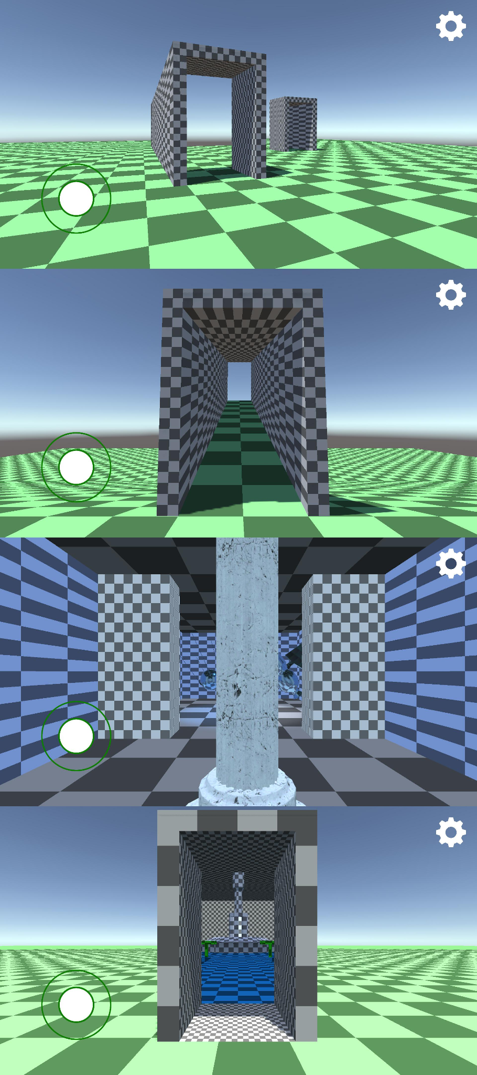
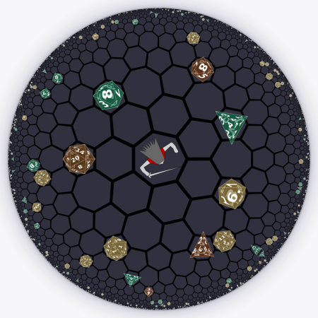
Problem Statement
Current State of Non-Euclidean games:
Limits in rendering techniques
Primary focus in experimentation or research
Therefore, our goal is to build a Non-Euclidean rendering engine and build a entertaining game on top of the engine.
| Lights Out
| Non-Euclidean Game
PROTOTYPING | 3
Notes:
Zach:
–improve
–mention game problem statement

Slide 5
Prototype - Game Design
A basic outline of the home scene and farmer mechanics.
Purpose:
Outline the basic game mechanics
Determine what exactly is needed from the engine team
Outcomes:
Basic Storyline
| Lights Out
| Non-Euclidean Game
PROTOTYPING | 4
Notes:
Zach:
–improve
–mention game problem statement

Slide 6
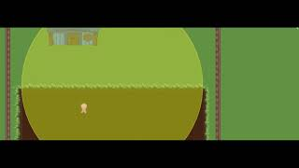
Prototype - Game Design
PUT VIDEO HERE
| Lights Out
| Non-Euclidean Game
PROTOTYPING | 5
Notes:
Zach:
–improve
–mention game problem statement

Slide 7
Prototype - Rendering Engine
A template for the Rendering Engine has been prototyped, with the basic features implemented for the rendering loop. Features will be expanded upon throughout development.
Purpose:
Begin Outlining Engine Prior to Game Development
Prevent Issues from Blocking Engine and Game Development
Outcomes:
Templating of Rendering Engine
Basic Rendering Loop to Abstract and Improve
| Lights Out
| Non-Euclidean Game
PROTOTYPING | 6
Notes:
Zach:
–improve
–mention game problem statement

Slide 8
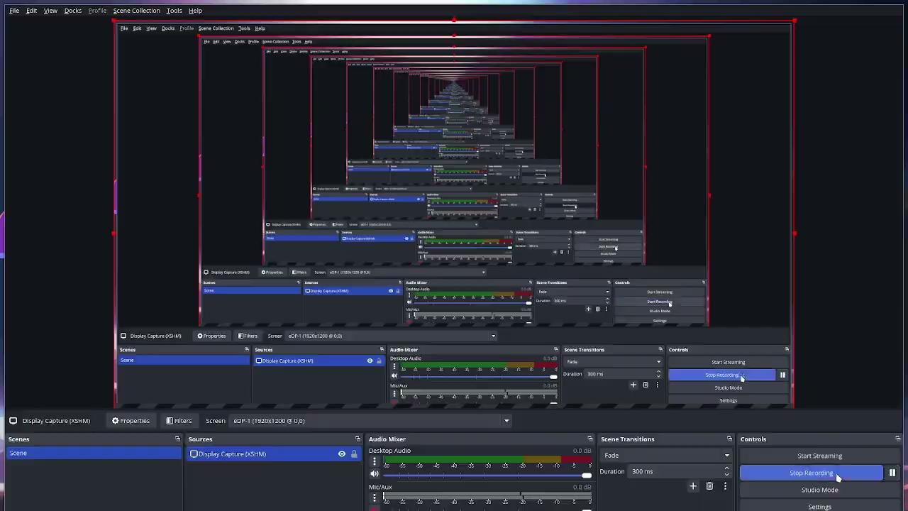
Prototype - Render Engine
PUT VIDEO HERE
| Lights Out
| Non-Euclidean Game
PROTOTYPING | 7
Notes:
Zach:
–improve
–mention game problem statement

Slide 9
Next Steps - Game Design
Unity Prototypes:
We Have:
Basic game design features
Solid storyline
Next Steps:
Combining Features into one cohesive demo
Finish creating features that are specific to our game
| Lights Out
| Non-Euclidean Game
PROTOTYPING | 8
Notes:
Zach:
–improve
–mention game problem statement

Slide 10
Next Steps - Rendering Engine
Rendering Engine Prototype:
We Have:
Discovered Engine Classes to Abstract
Learned the Difficulties of Implementing the Non-Euclidean Math
Next Steps:
Continue Polishing Abstractions
Finish Non-Euclidean Shaders & Conversions
| Lights Out
| Non-Euclidean Game
PROTOTYPING | 8
Notes:
Zach:
–improve
–mention game problem statement

Slide 11
Questions?
| sdmay25-37

Slide 12
Project Members
Tasman Grinnell
Project Manager
Rendering Engineer
Josh Deaton
Rendering Engine Lead
Lincoln Kness
Game Design Lead
Web Developer
Ben Johnson
Rendering Engineer
Zach Rapoza
Game Design Engineer
Spencer Thiele
Game Design Engineer
Cory Roth
Rendering and Game Design Engineer
| sdmay25-37

