Slide 1
Design Check In
Non-Euclidean Game - Lights Out
Project Members: Tasman Grinnell, Ben Johnson, Josh Deaton
Cory Roth, Zach Rapoza, Spencer Thiele, Lincoln Kness
Advisor: Dr. Joseph Zambreno
Client: Josh Deaton
| sdmay25-37
Notes:
Introduce Everyone

Slide 2
Project Overview
This project aims to:
Create a Non-Euclidean 2-dimensional game/rendering engine
Design and develop a game to showcase the engine
| Lights Out
| Non-Euclidean Game
DESIGN CHECK IN | 1
Notes:
Tasman

Slide 3
Project Deliverables
The final deliverables are:
A working game/rendering engine featuring Non-Euclidean Geometry
A finished and polished videogame matching:
Design Requirements
Functional Requirements
| Lights Out
| Non-Euclidean Game
DESIGN CHECK IN | 2
Notes:
Tasman

Slide 4
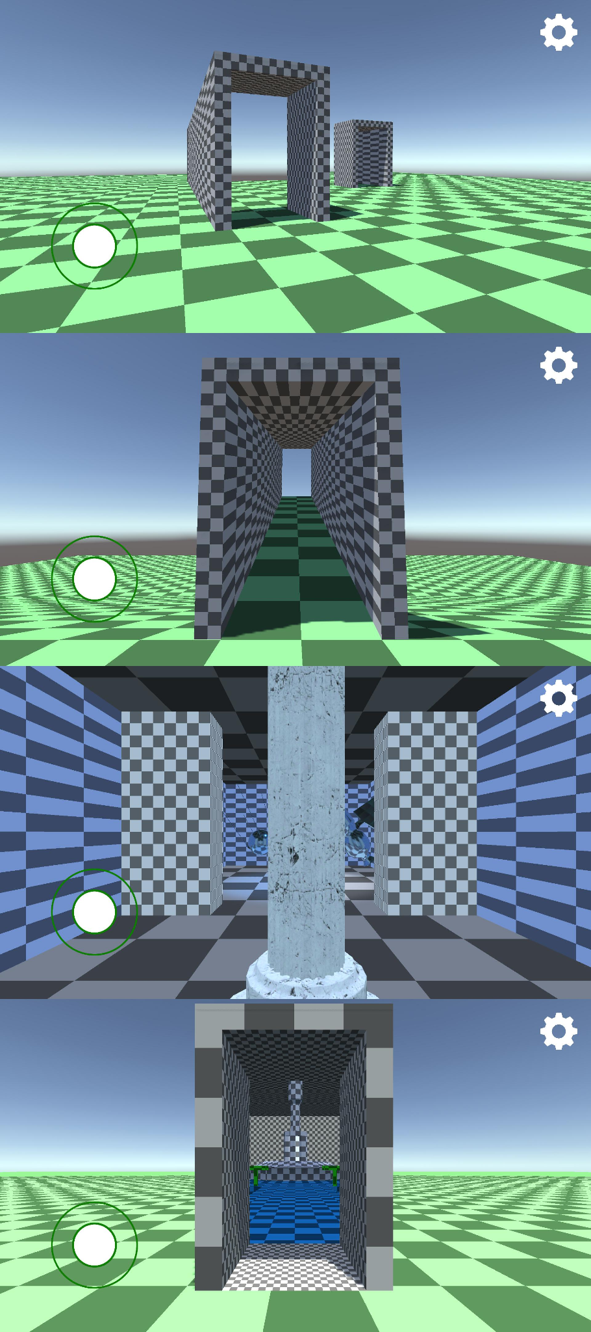
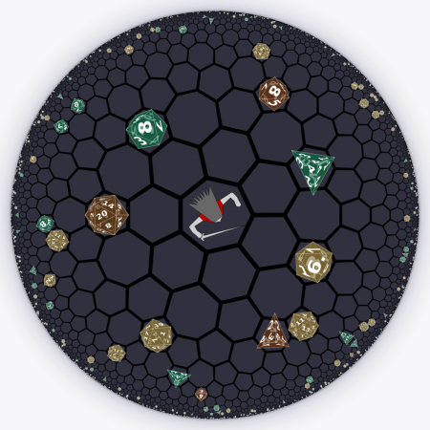
Problem Statement
Current State of Non-Euclidean games:
Limits in rendering techniques
Primary focus in experimentation or research
Our Goal: build a non-Euclidean rendering engine and a game to go on top of the engine.
| Lights Out
| Non-Euclidean Game
DESIGN CHECK IN | 3
Notes:
Zach:
–improve
–mention game problem statement

Slide 5
Current Design
Game Design:
Scripts and classes for the inventory, farmer, monsters, farm scene
Consolidation of the farm, monsters, and farmer packages
Engine Team:
Main Class for General Rendering Loop
Entity-Component-System for Memory Management
Abstractions (e.g. Mathematical transformations, inputs, etc.)
| Lights Out
| Non-Euclidean Game
DESIGN CHECK IN | 4
Notes:
Zach:
–improve
–mention game problem statement

Slide 6
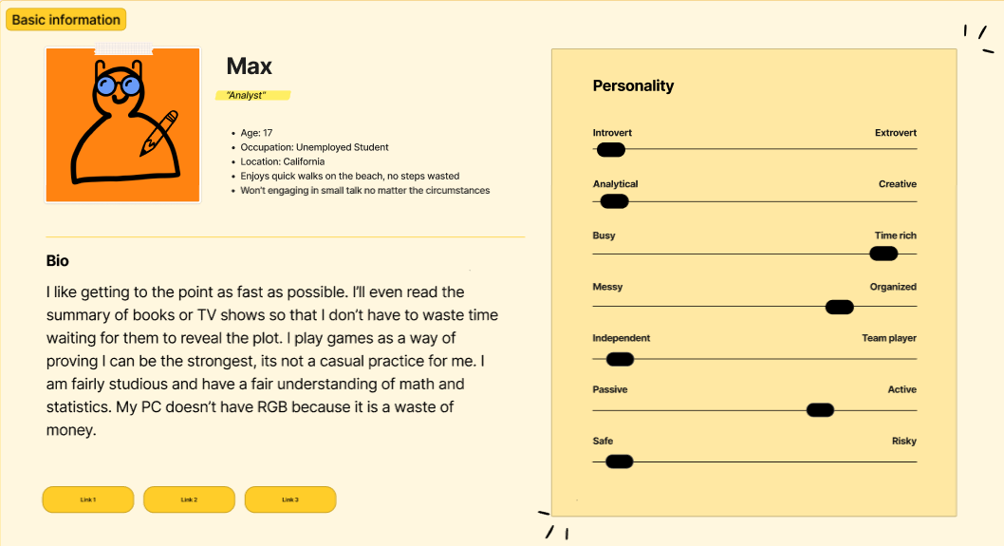
Human
User Needs: The current solution addresses the primary need for an enjoyable experience, with progress showing alignment with this goal.
Technical Focus: Emphasis on ensuring smooth gameplay by optimizing the rendering engine for non-Euclidean space.
| Lights Out
| Non-Euclidean Game
DESIGN CHECK IN | 5
Notes:
Zach:
–improve
–mention game problem statement

Slide 7
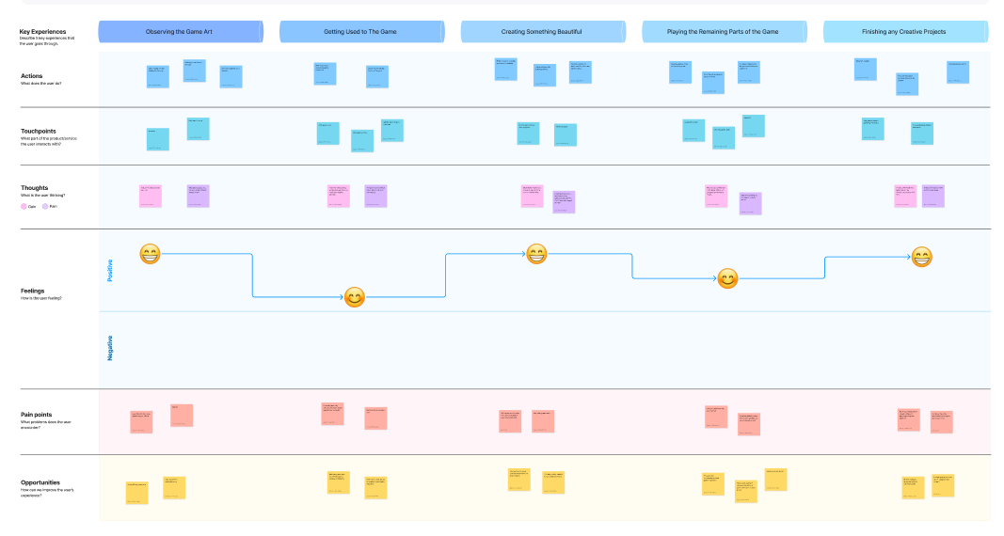
Artifacts - Journey Map
| Lights Out
| Non-Euclidean Game
Figma Link
DESIGN CHECK IN | 6
Notes:
Zach:
–improve
–mention game problem statement

Slide 8
Economic
Improvement over existing solutions: Aims to create an enjoyable game in non-Euclidean space, unlike most experimental prototypes.
Drawback: Limited timetable of less than a year to complete the project (due to senior design constraints).
Challenge: Less time for polish, as most modern games take longer to develop.
Mitigation: Task delegation and strong internal deadlines to stay on schedule and allow time for polishing.
| Lights Out
| Non-Euclidean Game
DESIGN CHECK IN | 7
Notes:
Zach:
–improve
–mention game problem statement

Slide 9
Artifacts - Pro/Con Table
 | Pros | Cons
HyperRogue | Smooth gameplay Polished programming Non-euclidean math | The bare bones of a game Poor UI Crashes often
Stardew Valley | Simple Mechanics It runs well on machines Enjoyable to play | Not non-euclidean math Slow gameplay cycle
Unity | Lots of resources Ease of implementation Already existing engine | Lacks computational efficiency when developing non standard game mechanics Lacks the ability to integrate own engine
| Lights Out
| Non-Euclidean Game
DESIGN CHECK IN | 8
Notes:
Zach:
–improve
–mention game problem statement

Slide 10
Technical
Internal Complexity:
Non-Euclidean Mathematics (conversions to Euclidean Space)
Software Complexity:
Languages and Tooling (C++, OpenGL, Unity, various libraries)
System Handling:
Entity-Component-System (ECS) for Memory Management
Input Handling
Game Design Complexity:
Object Collision
Lighting
Movement
External Complexity:
Interaction Mediums (Monitors, Keyboards, Controller)
Performance Requirements
| Lights Out
| Non-Euclidean Game
DESIGN CHECK IN | 9
Notes:
Zach:
–improve
–mention game problem statement

Slide 11
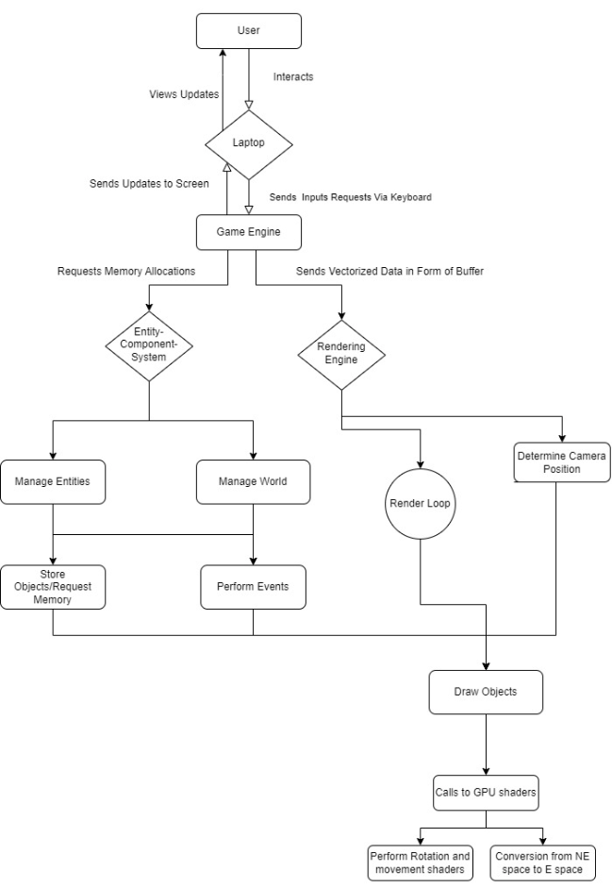
Artifacts - Technical Complexity Analysis
Rendering Engine
Processes vectorized data
Sends Frame to the laptop
Entity Component System (ECS)
Manages memory allocation
Handles User Input
Game Engine
Receives user input and directs it to the appropriate system
Updates frames based on rendering engine data
Laptop
Main I/O device
Sends user input to the game engine
| Lights Out
| Non-Euclidean Game
DESIGN CHECK IN | 10
Notes:
Zach:
–improve
–mention game problem statement

Slide 12
Conclusions
Current Design
Initial Prototypes and High-Level Game Designs
Discussion of Prototyped Engine Organization
Human Needs
Enjoyable Gameplay and Technical Performance Requirements
Economic
Challenging Industry Standards
Many Constraints (Primarily Related to Timeline)
Technical Complexity
Engine and Game Development (New Tools and Programming Models)
Hosted Mathematic Conversions (e.g. Projections, Translations)
| Lights Out
| Non-Euclidean Game
DESIGN CHECK IN | 10
Notes:
Zach:
–improve
–mention game problem statement

Slide 13
Questions?
| sdmay25-37

Slide 14
Project Members
Tasman Grinnell
Project Manager
Rendering Engineer
Josh Deaton
Rendering Engine Lead
Lincoln Kness
Game Design Lead
Web Developer
Ben Johnson
Rendering Engineer
Zach Rapoza
Game Design Engineer
Spencer Thiele
Game Design Engineer
Cory Roth
Rendering and Game Design Engineer
| sdmay25-37

