Slide 1
Detailed Design
Non-Euclidean Game - Lights Out
Project Members: Tasman Grinnell, Ben Johnson, Josh Deaton
Cory Roth, Zach Rapoza, Spencer Thiele, Lincoln Kness
Advisor: Dr. Joseph Zambreno
Client: Josh Deaton
| sdmay25-37

Slide 2
Project Overview
This project aims to:
Create a Non-Euclidean 2-dimensional game/rendering engine
Design and develop a game to showcase the engine
| Lights Out
| Non-Euclidean Game
Detailed Design | 1

Slide 3
Project Deliverables
The final deliverables are:
A working game/rendering engine featuring Non-Euclidean Geometry
A finished and polished videogame matching:
Design Requirements
Functional Requirements
| Lights Out
| Non-Euclidean Game
Detailed Design | 2

Slide 4
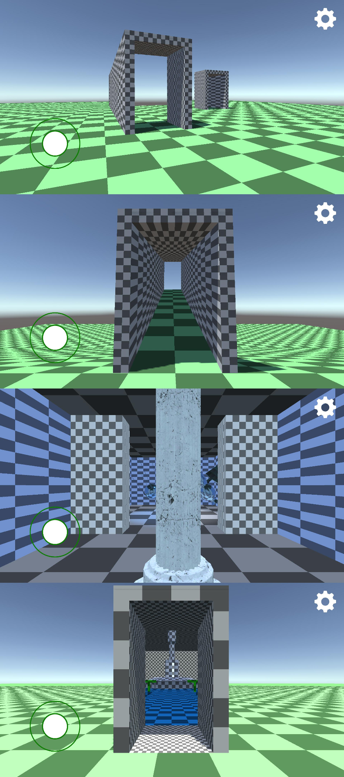
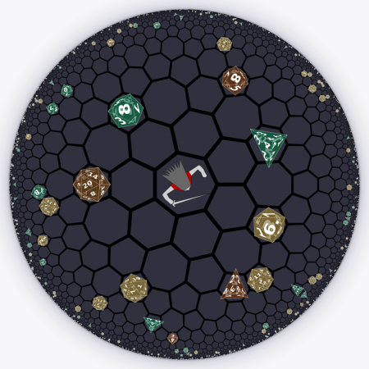
Problem Statement
Current State of Non-Euclidean games:
Limits in rendering techniques
Primary focus in experimentation or research
Therefore, our goal is to build a Non-Euclidean rendering engine and build a entertaining game on top of the engine.
| Lights Out
| Non-Euclidean Game
Detailed Design | 3

Slide 5
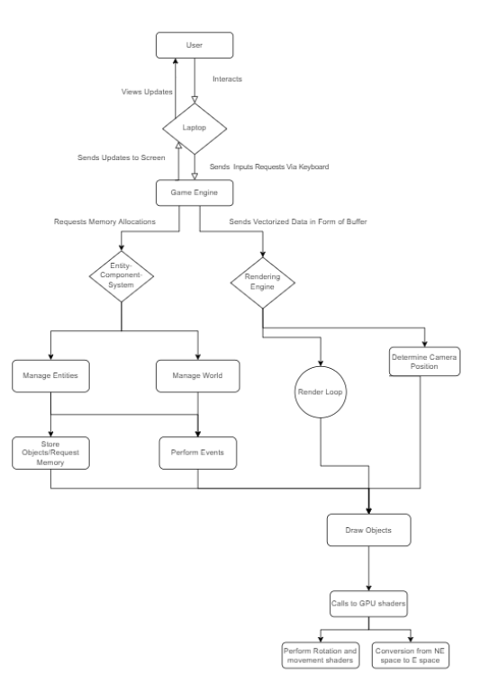
Detailed Design and Visuals
The Rendering Engine
The rendering engine will take vectorized data from the game executable and process it. It will compute the updated graphics that need to be presented for a frame in a non euclidean manner. It will send the frame to the laptop to be visualized. It will use resources that are allocated by the ECS.
Entity Component System
The entity component system is in charge of maintain the memory allocation of all the sprites and entities that are required. Some inputs of the user will require us to load objects from memory to be used. Computer graphics have memory accesses that are easily predicted so having a system in charge of this will allow for better performance. It will also be in charge of handling events that happen in the game.
Game Engine
The game engine is responsible for taking in inputs from the laptop and tasking the appropriate system on what to do. It will either send data to the rendering engine or the Entity-Component system or both. It will receive data back from the rendering engine with the appropriate updates to the frame
Laptop
The laptop is the main I/O device for the user as well as the system that the Game Engine, ECS, and Rendering Engine will run on. A laptop will consist of a keyboard that will be used as the input the user will make. It will send these inputs to the game engine. It will receive data from the engine which will be a new frame that the laptop can display on its screen so the user can see.
| Lights Out
| Non-Euclidean Game
Detailed Design | 4

Slide 6
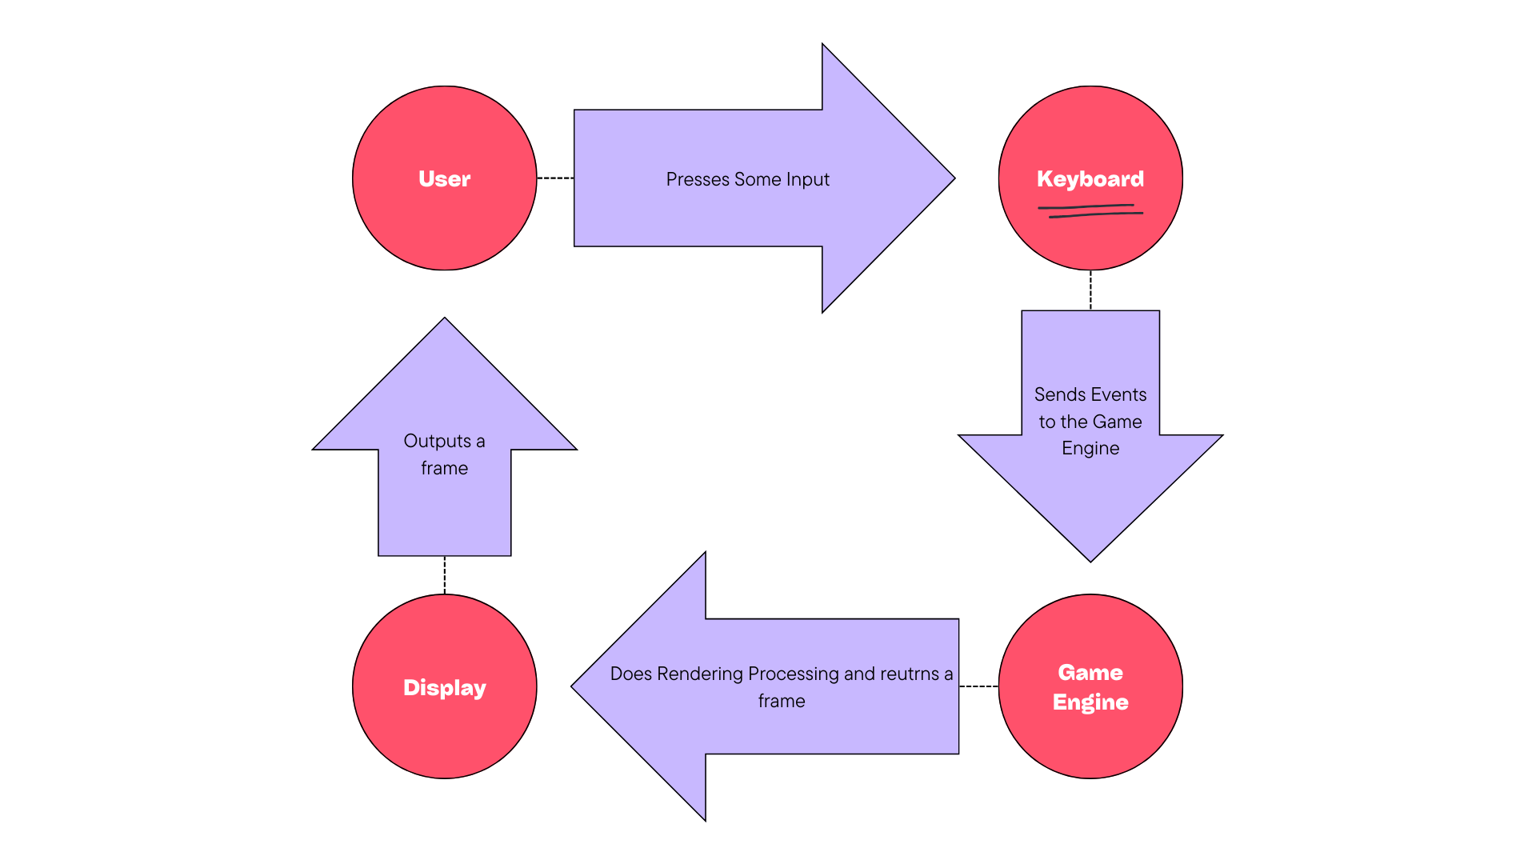
Functionality
The user will use a computer to give inputs
These are caught by the game engine and events are tasked out the the appropriate driver
The Backend components do the proper work (memory management or rendering)
It returns with data to create a frame on the display
The laptop displays the frame
User views screen to make new inputs
| Lights Out
| Non-Euclidean Game
Detailed Design | 5

Slide 7
Technology Considerations
Technology | Pros | Cons
OpenGL | State of the Art Easy Rendering Language to Learn Cross Platform | Performance variability between platforms
Unity | State of the Art “Free” to use Generic use Documentation/Resources | Not customizable at the engine level Poor optimization for what we are trying to accomplish
GitHub/Unity Version Control (UVC) | Version Control Task Allocation/Management | Github–limited file size Github–does not handle unity resources very well UVC–not free
Personal Laptop | Ease of Use Easy to Test (we all have one) Easy to transport | Limited computing resources Take off (in class)
| Lights Out
| Non-Euclidean Game
Detailed Design | 6

Slide 8
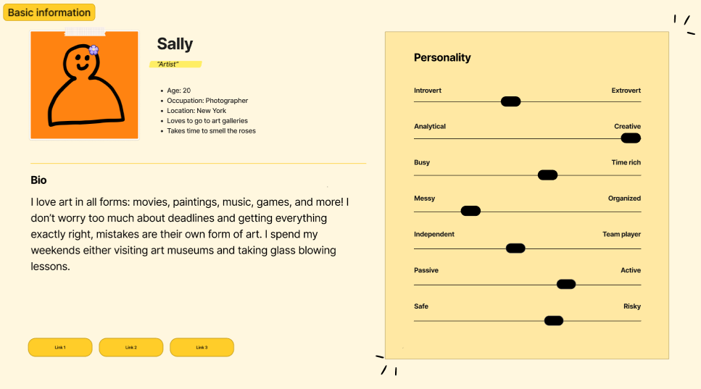
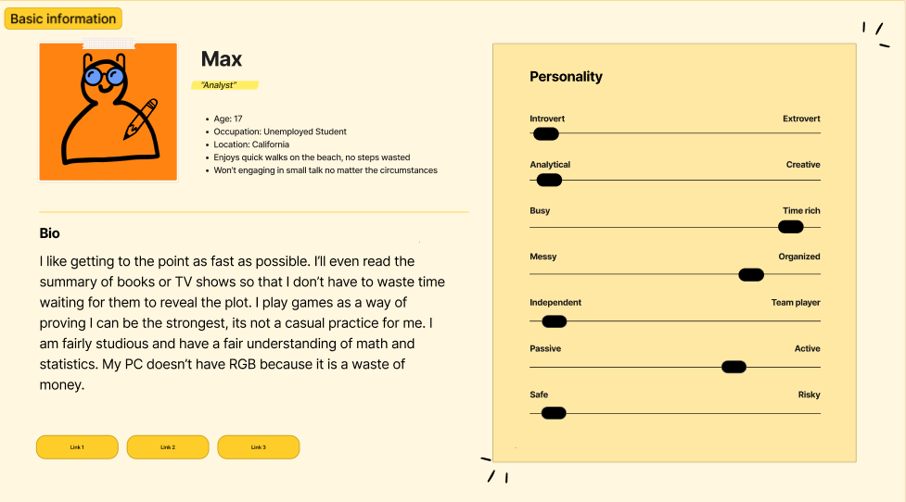
Areas of Concern and Development
Meeting user design constraints when it comes to artistic choices
Creating functional and entertaining game mechanics surrounding the farming aspects of our game
Time constraints and integration between the design and the engine
| Lights Out
| Non-Euclidean Game
Detailed Design | 7

Slide 9
Conclusions
The detailed designs closely relate to the overall engine operation loop and support the designs from the engine team.
High level interactions between the user and the executable itself with processing inputs and outputting results.
Overall considerations for technology used for the project have been compared and contrasted through pros and cons.
The main sources of concern are:
Meeting user requirements for artistic choices.
Creating a functioning and entertaining game.
Timely integrating design requirements into the engine.
| Lights Out
| Non-Euclidean Game
Detailed Design | 8

Slide 10
Questions?
| sdmay25-37

Slide 11
Project Members
Tasman Grinnell
Project Manager
Rendering Engineer
Josh Deaton
Rendering Engine Lead
Lincoln Kness
Game Design Lead
Web Developer
Ben Johnson
Rendering Engineer
Zach Rapoza
Game Design Engineer
Spencer Thiele
Game Design Engineer
Cory Roth
Rendering and Game Design Engineer
| sdmay25-37

