Slide 1
Project Management
Non-Euclidean Game - Lights Out
Tasman Grinnell, Ben Johnson, Josh Deaton
Cory Roth, Zach Rapoza, Spencer Thiele, Lincoln Kness
| sdmay25-37
Notes:
Introduce Everyone

Slide 2
Project Overview
This project aims to:
Create a Non-Euclidean 2-dimensional game/rendering engine
Design and develop a game to showcase the engine
| Lights Out
| Non-Euclidean Game
PROJECT MANAGEMENT | 1
Notes:
Tasman

Slide 3
Project Deliverables
The final deliverables are:
A working game/rendering engine featuring Non-Euclidean Geometry
A finished and polished videogame matching:
Design Requirements
Functional Requirements
| Lights Out
| Non-Euclidean Game
PROJECT MANAGEMENT | 2
Notes:
Tasman

Slide 4
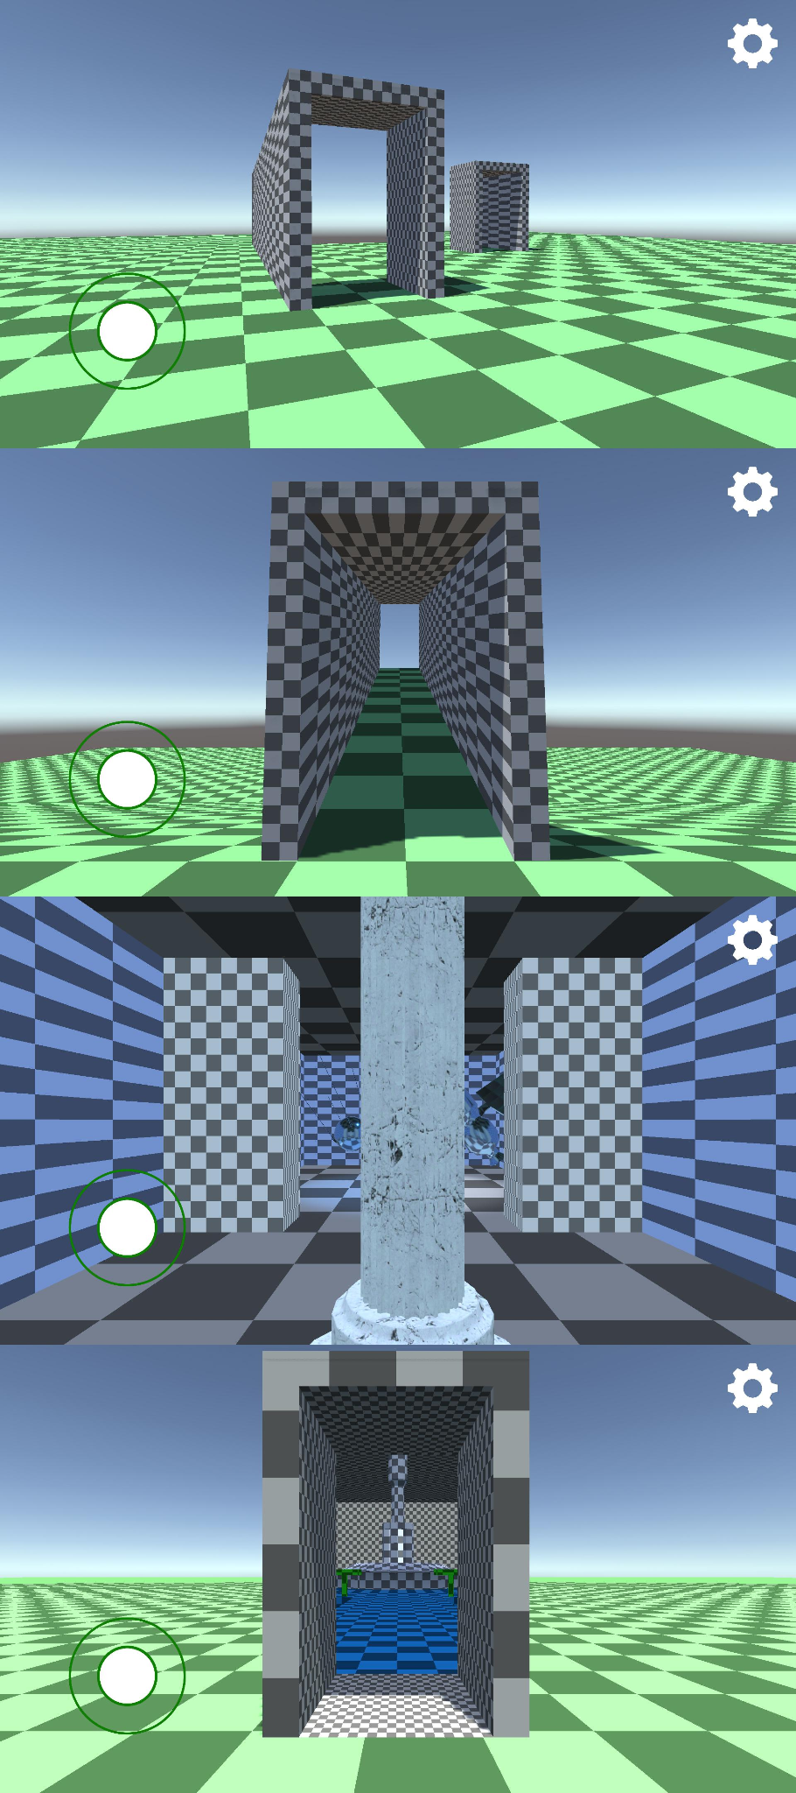
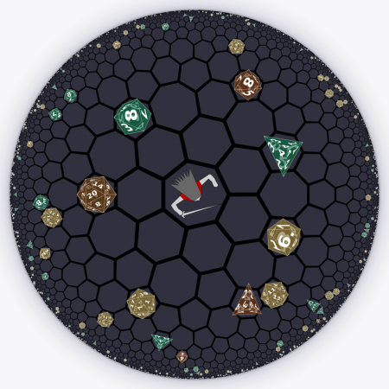
Problem Statement
Current State of Non-Euclidean games:
Limits in rendering techniques
Primary focus in experimentation or research
Therefore, our goal is to build a Non-Euclidean rendering engine and build a entertaining game on top of the engine.
| Lights Out
| Non-Euclidean Game
PROJECT MANAGEMENT | 3
Notes:
Zach:
–improve
–mention game problem statement

Slide 5
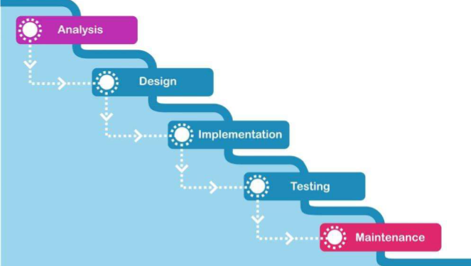
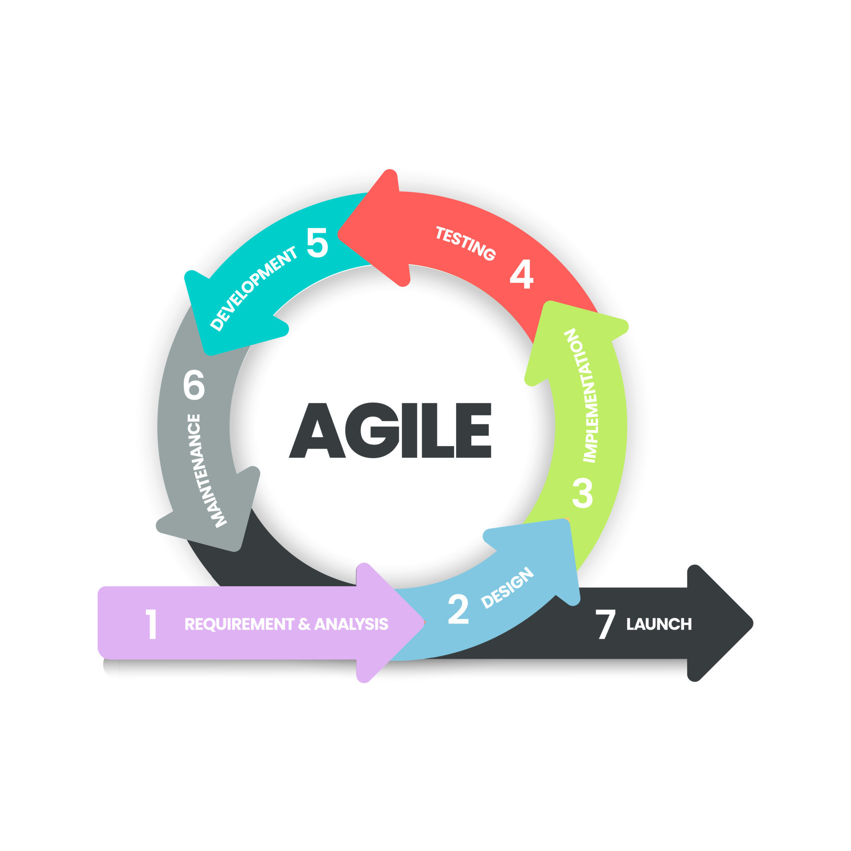
Project Management Style
Hybrid Style
Waterfall Aspects
Hard to start next task without previous one done
Project will not have a working demo until end of semester
Makes managing timeline and scope easier
Agile Aspects
Multiple weekly meetings
Regular feedback from client
Changing requirements
| Lights Out
| Non-Euclidean Game
PROJECT MANAGEMENT | 4
Notes:
Cory
Waterfall-style task decomposition and schedule
Tasks complete via agile methods

Slide 6
Project Timeline
| Lights Out
| Non-Euclidean Game
PROJECT MANAGEMENT | 5
Notes:
Spencer

Slide 7
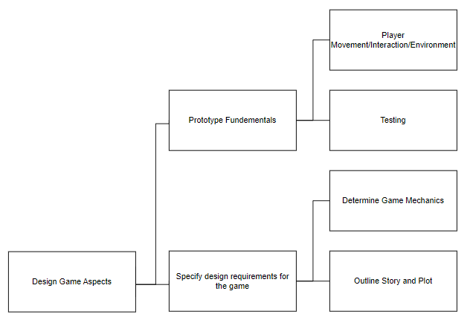
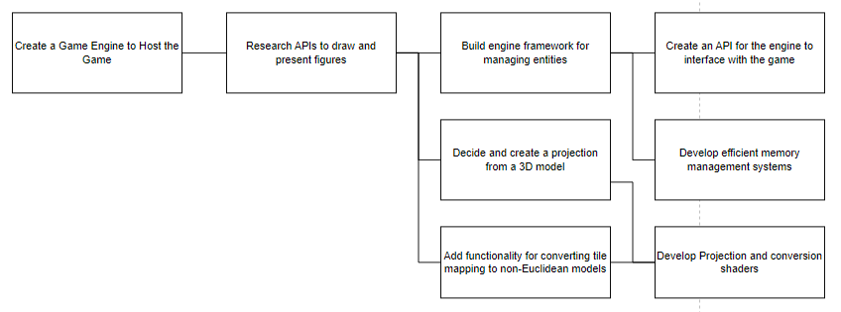
Task Decomposition
First Semester:
Groundwork for Game Development
Game Design
Specify Requirements
Create Prototypes
Rendering Engine
Support Design Requirements
Host projection calculations
Create memory and entity management systems
| Lights Out
| Non-Euclidean Game
PROJECT MANAGEMENT | 6
Notes:
Ben

Slide 8
Key Milestones
Prototypes
Creation of mockups/demos
Game Engine/Development Completion
Does the engine/game work?
Performance
Compute resource use/availability
| Lights Out
| Non-Euclidean Game
PROJECT MANAGEMENT | 7
Notes:
Lincoln

Slide 9
Key Risks and Mitigation Strategies
Class Documentation/Assignments
Pinging, Bothering, and Regular Reminders
Blocking Points in Development
Prototyping
Game Development demands for Game Engine
Behind on Tasks
Communication during regular meetings
Reassignment of tasks
| Lights Out
| Non-Euclidean Game
PROJECT MANAGEMENT | 8
Notes:
Josh
Prototyping: Mitigates the risk of unnecessary engine development

Slide 10
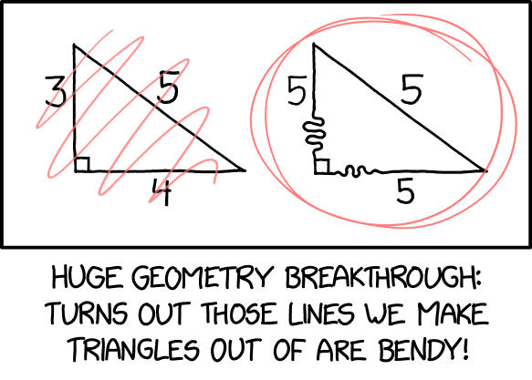
Conclusions
Management Style
Hybrid Style
Decomposing tasks by team
Ensure staying on track with team communication
Overall Schedule
Unity demo by end of December
Prototype of a non-euclidean world by end of December
| Lights Out
| Non-Euclidean Game
PROJECT MANAGEMENT | 9
Notes:
Josh
Prototyping: Mitigates the risk of unnecessary engine development

Slide 11
Questions?
| sdmay25-37

Slide 12
Project Members
Tasman Grinnell
Project Manager
Rendering Engineer
Josh Deaton
Rendering Engine Lead
Lincoln Kness
Game Design Lead
Web Developer
Ben Johnson
Rendering Engineer
Zach Rapoza
Game Design Engineer
Spencer Thiele
Game Design Engineer
Cory Roth
Rendering and Game Design Engineer
Lights Out - Non-Euclidean Game

