Slide 1
Lighting Talk #3
User Needs and Requirements
sdmay25-37

Slide 2
Project Overview
This project aims to create a 2 dimensional rendering engine using Non-Euclidean rendering techniques and then design and develop a game that will run on said engine

Slide 3
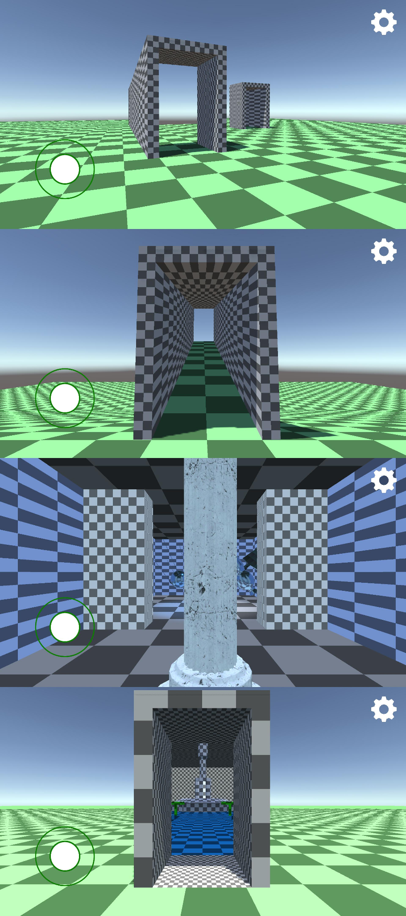
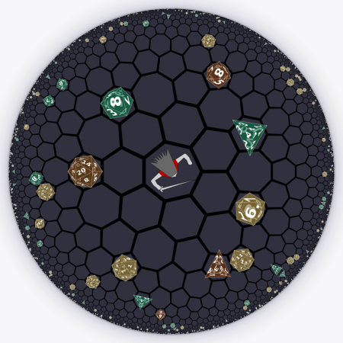
Problem Statement
Current non-Euclidean game design is limited to computer tricks, such as teleportation, or conditional rendering.
Games that perform non-Euclidean transformations tend to have poor game design or are focused on research.
Our goal is to build a non-Euclidean rendering engine and build a entertaining game on top of the engine.

Slide 4
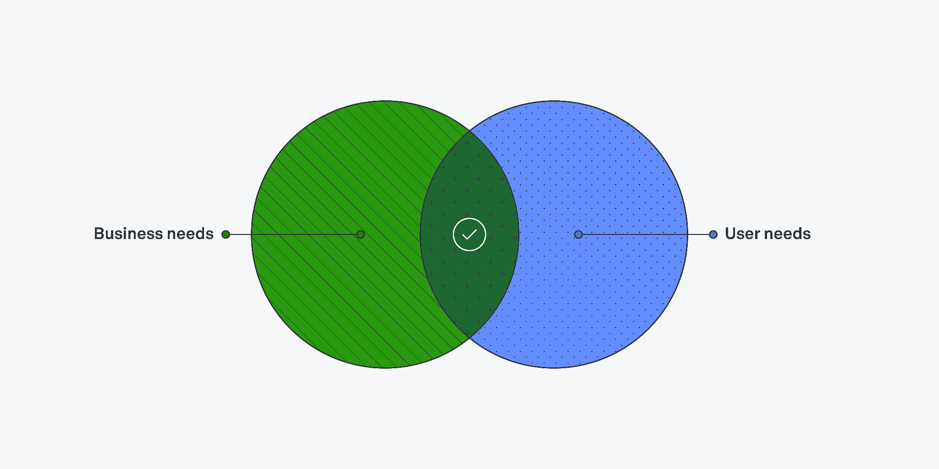
User needs
A well balanced game (fun vs skill)
Polished Game (few bugs detrimental to gameplay, smooth experience, immersive)
Thoughtful Design points (in-game resources, stats, etc)
Cohesive with sound design and art

Slide 5
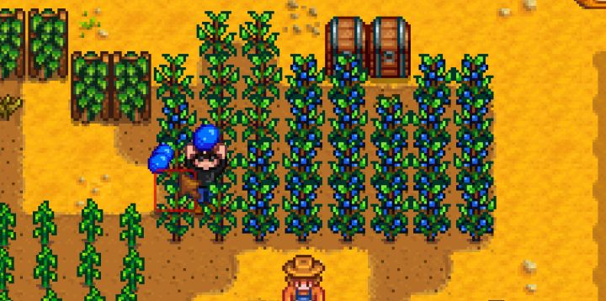
Requirements - Gameplay
Engaging through character management and interesting user interactions
Balance between difficulty and an enjoyable experience
Engaging and unique lore meshing with the non-Euclidean space
Novelty of new geometrical engine
Options to heavily optimize and improve through in-game mechanics
Cater to a variety of playstyles
Notes:
Engaging through character management and interesting user interactions (e.g. world, monsters, etc)
Balance between difficulty and an enjoyable experience
Engaging and unique lore meshing with the non-Euclidean space
Novelty of new geometrical engine (interesting interactions, unique gameplay)
Options to heavily optimize and improve through in-game mechanics (combat, character stats, skillful gameplay)
Cater to a wide variety of playstyles (efficient, casual, hardcore)

Slide 6
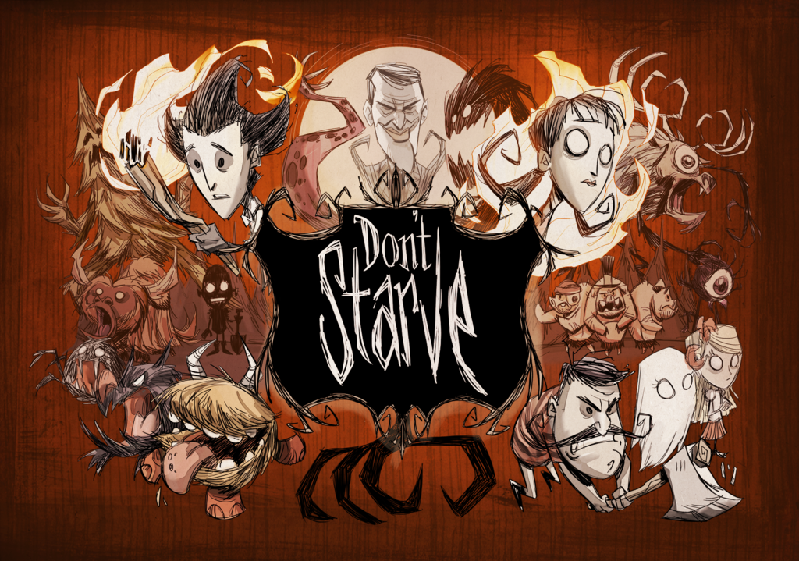
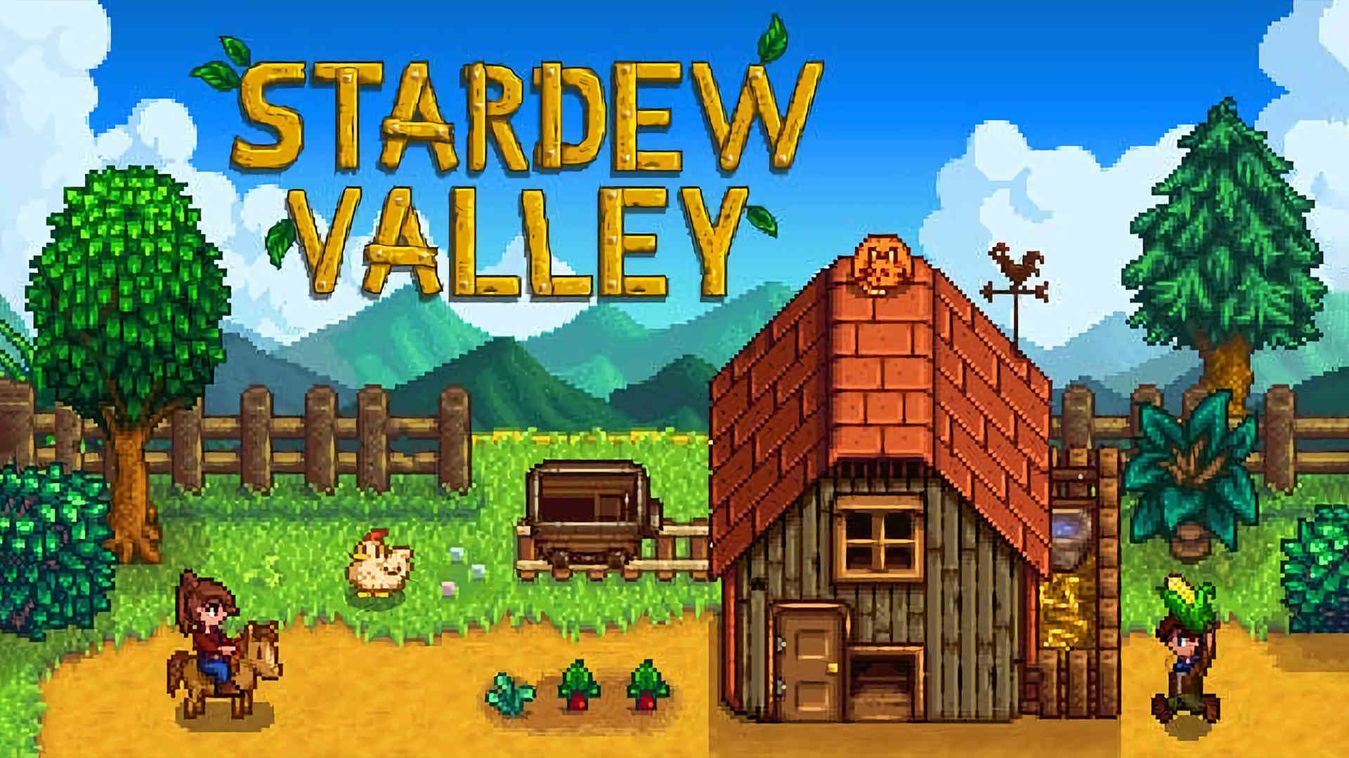
Requirements - Presentation
Cohesive and polished art design
Complete in all aspects of the art (sprites, visual style, music)
Smooth experience, high performance (detail and framerate)

Slide 7
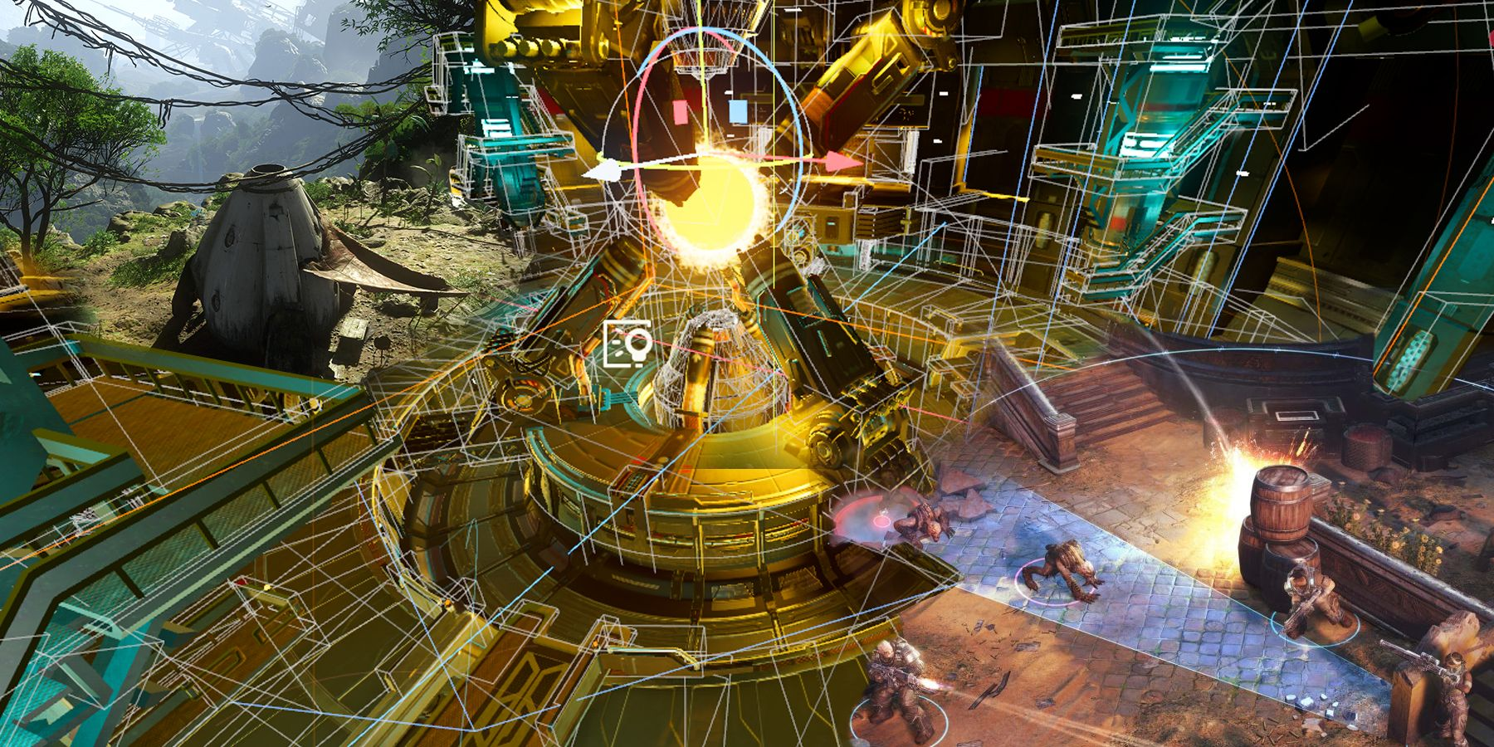
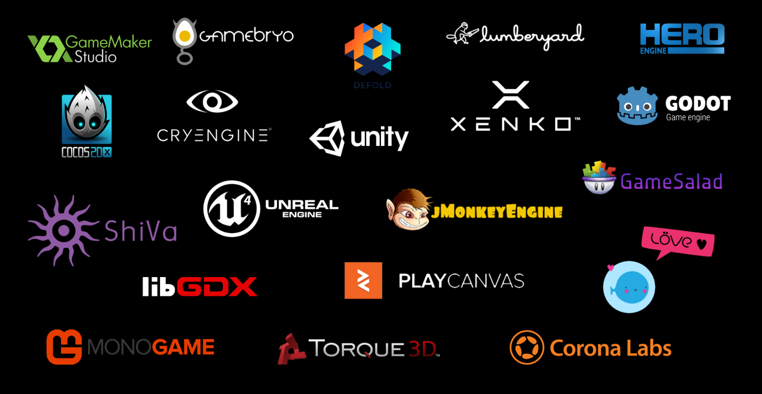
Requirements - Game Engine
Efficiently support design and gameplay
Support the hosting of a world on a 3D hyperbolic surface or on a hyperbolic tiling
Support the transformation of a 3D hyperbolic surface or tiling to a 2D plane
Host Non-Euclidean Math Functions (conversions from Euclidean → Non-Euclidean)

Slide 8
Engineering Standards
Software Life Cycles
Software Testing
Project Management - 16326-2009
Quality Assurance - IEEE 730.1-1995
Standard for Video Games Vocabulary
IEEE Standard Glossary of Computer Graphics Terminology
Information technology — Computer graphics — Interfacing techniques for dialogues with graphical devices (CGI) — Functional specification

Slide 9
Conclusions
Gameplay Requirements - Engaging game mechanics alongs side of a cohesive lore meshing with a non-euclidean world
Presentation Requirements - Polished and unique art that emphasizes the distortion created by non-euclidean world
Rendering Engine Requirements - Efficiently support game design requirements and host non-euclidean math functions

