Slide 1
Lighting Talk #2
Problem and Users
sdmay25-37

Slide 2
Project Overview
This project aims to create a 2 dimensional rendering engine using Non-Euclidean rendering techniques and then design and develop a game that will run on said engine

Slide 3
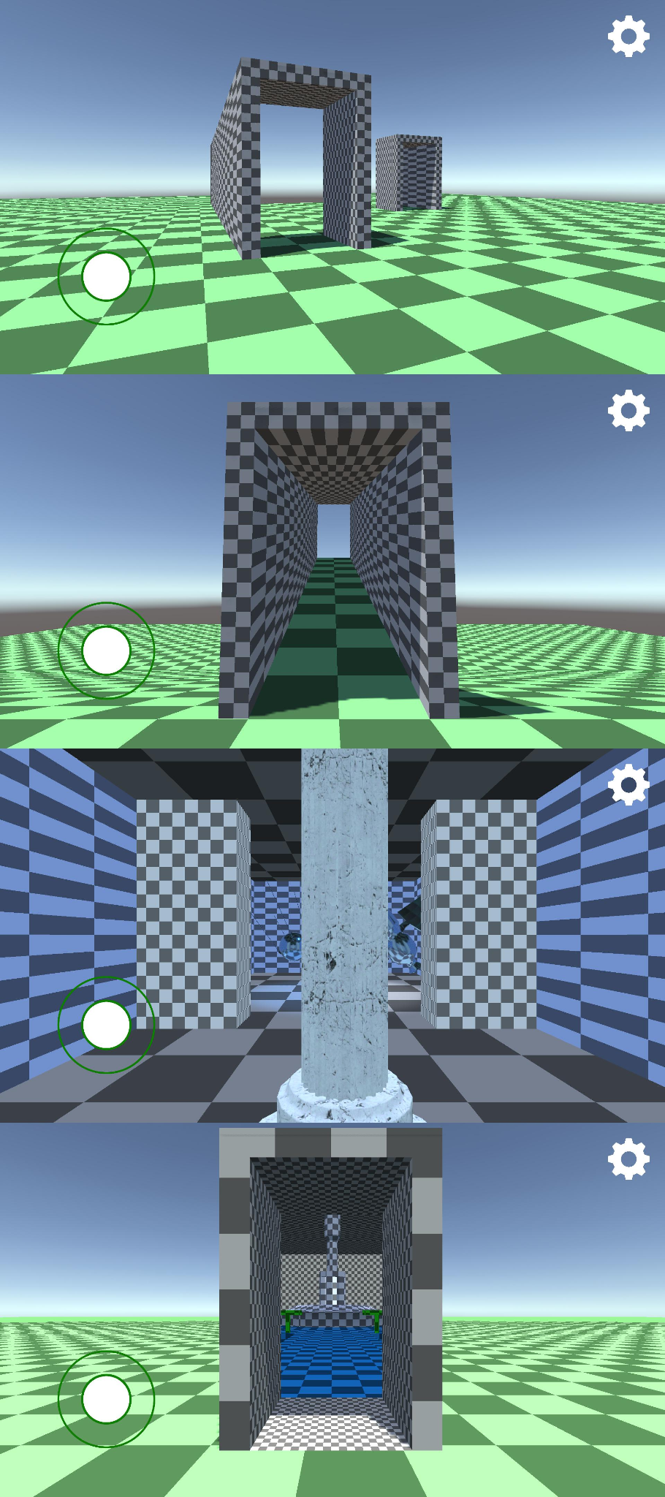
Problem Statement
Current non-Euclidean game design is limited to computer tricks, such as teleportation, or conditional rendering.
Games that perform non-Euclidean transformations tend to have poor game design or are focused on research.
Our goal is to build a non-Euclidean rendering engine and build a entertaining game on top of the engine.

Slide 4
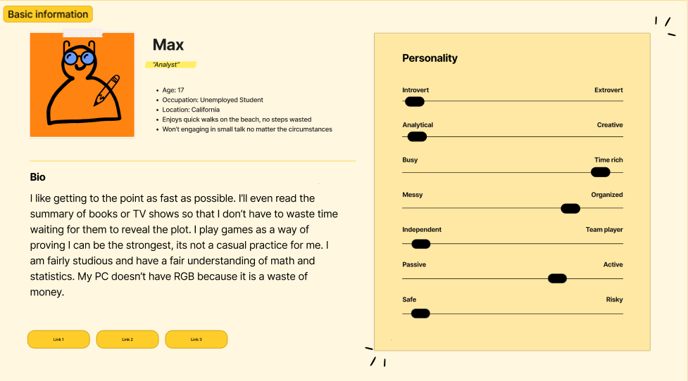
Persona 1 - Max
Max is an efficiency focused gamer who needs a way to optimize power and production in games because he enjoys creating well made systems.

Slide 5
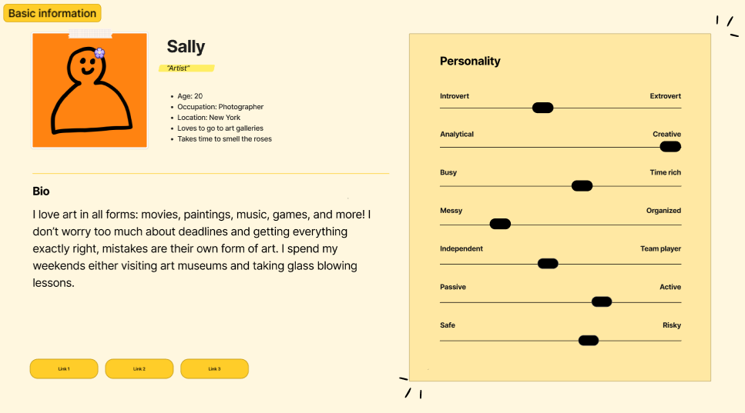
Persona 2 - Sally
Sally needs to have an enjoyable game that has an artistic touch because she loves art in all different forms ranging from music to the artistic style of the in game sprites.

Slide 6
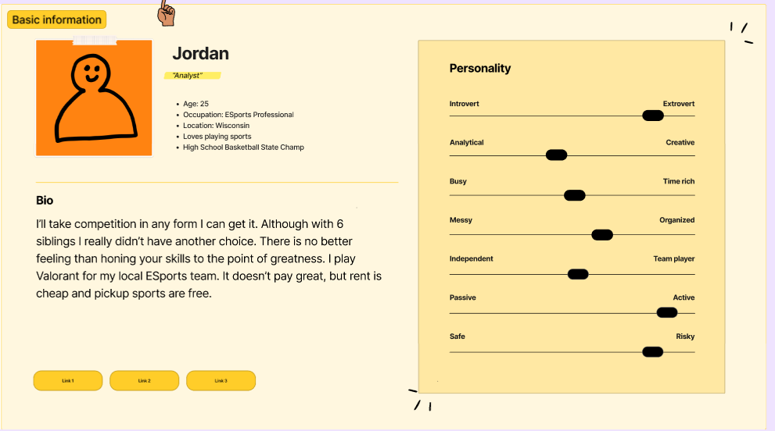
Persona 3 - Jordan
Jordan needs a way to have a challenging and engaging gaming experience because he enjoys challenges and becoming the best gamer he can.

Slide 7
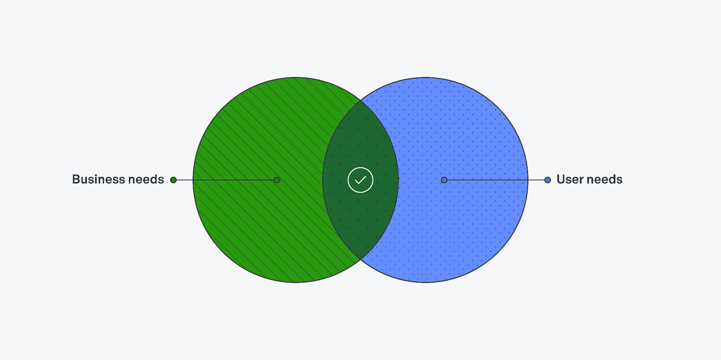
User Needs
A well balanced game (fun vs skill)
Polished Game (few bugs detrimental to gameplay, smooth experience, immersive)
Thoughtful Design points (in-game resources, stats, etc)
Cohesive with sound design and art

Slide 8
Conclusions
Max - Needs a well polished game with few bugs and consistent gameplay. Bugs and inconsistent gameplay will impede his ability to enjoy the game.
Sally - Needs a visually appealing gameplay experience to appeal to her love of artistic worlds, and sprites.
Jordan - Needs a difficult and challenging experience, giving opportunities to showcase his skill.
The final game must be well balanced, fun, and polished.

