Slide 1
Industry Review Panel Presentation
Non-Euclidean Game - Lights Out
Project Members: Tasman Grinnell, Ben Johnson, Josh Deaton
Cory Roth, Zach Rapoza, Spencer Thiele, Lincoln Kness
Advisor: Dr. Joseph Zambreno
Client: Josh Deaton
| sdmay25-37
Notes:
Introduce Everyone
Add captions for each of the images

Slide 2
Project Background
| sdmay25-37

Slide 3
Project Overview
This project aims to:
Create a Non-Euclidean 2-dimensional game/rendering engine
Design and develop a game to showcase the engine
| Project Overview
| Lights Out
| Non-Euclidean Game
Figure 1: Overview of Euclidean versus Non-Euclidean (Elliptical and Hyperbolic) Spaces.
Notes:
Taz

Slide 4
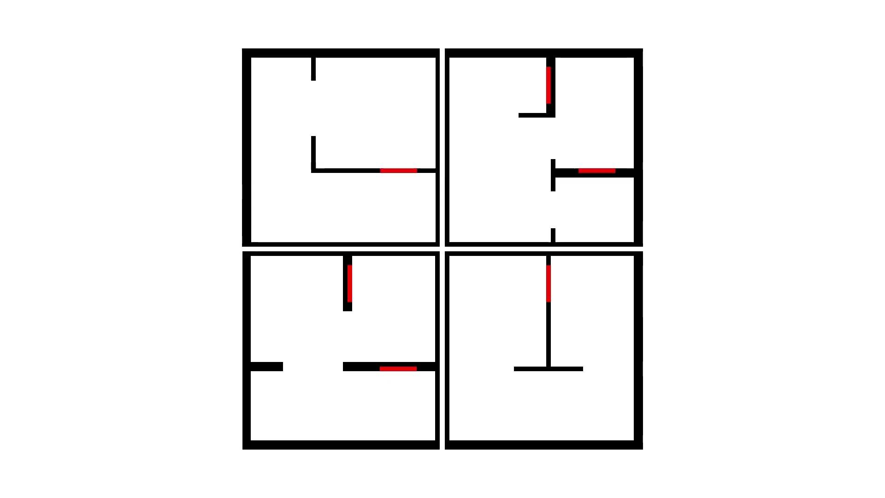
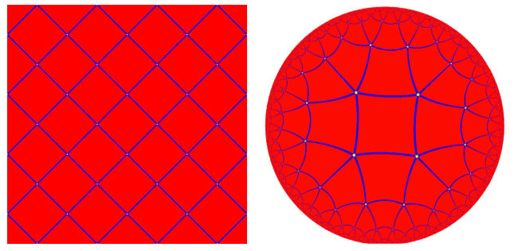
What do we mean by “Non-Euclidean”?
NOT classic portals or disappearing rooms
We want to model Hyperbolic Space, which is modeled on a Hyperboloid and projected onto a 2-Dimensional disk.
Figure 2: Common Non-Euclidean
style modeling
Figure 3: Projection of Hyperbolic Space on a 2-Dimensional Disk
Figure 4: Euclidean Square Tiling (left) vs a Hyperbolic Square Tiling (right)
| Project Overview
| Lights Out
| Non-Euclidean Game
Notes:
Taz

Slide 5
Project Motivation
Why This Project?
No specific Non-Euclidean shader support
General-purpose engines limit access to shaders
Mainstream games are mostly set in a normal 3D space
Industry is lacking in Non-Euclidean world support!
We want to innovate through developing a custom game engine and video game.
| Project Overview
| Lights Out
| Non-Euclidean Game
Notes:
Taz

Slide 6
Project Design
| sdmay25-37

Slide 7
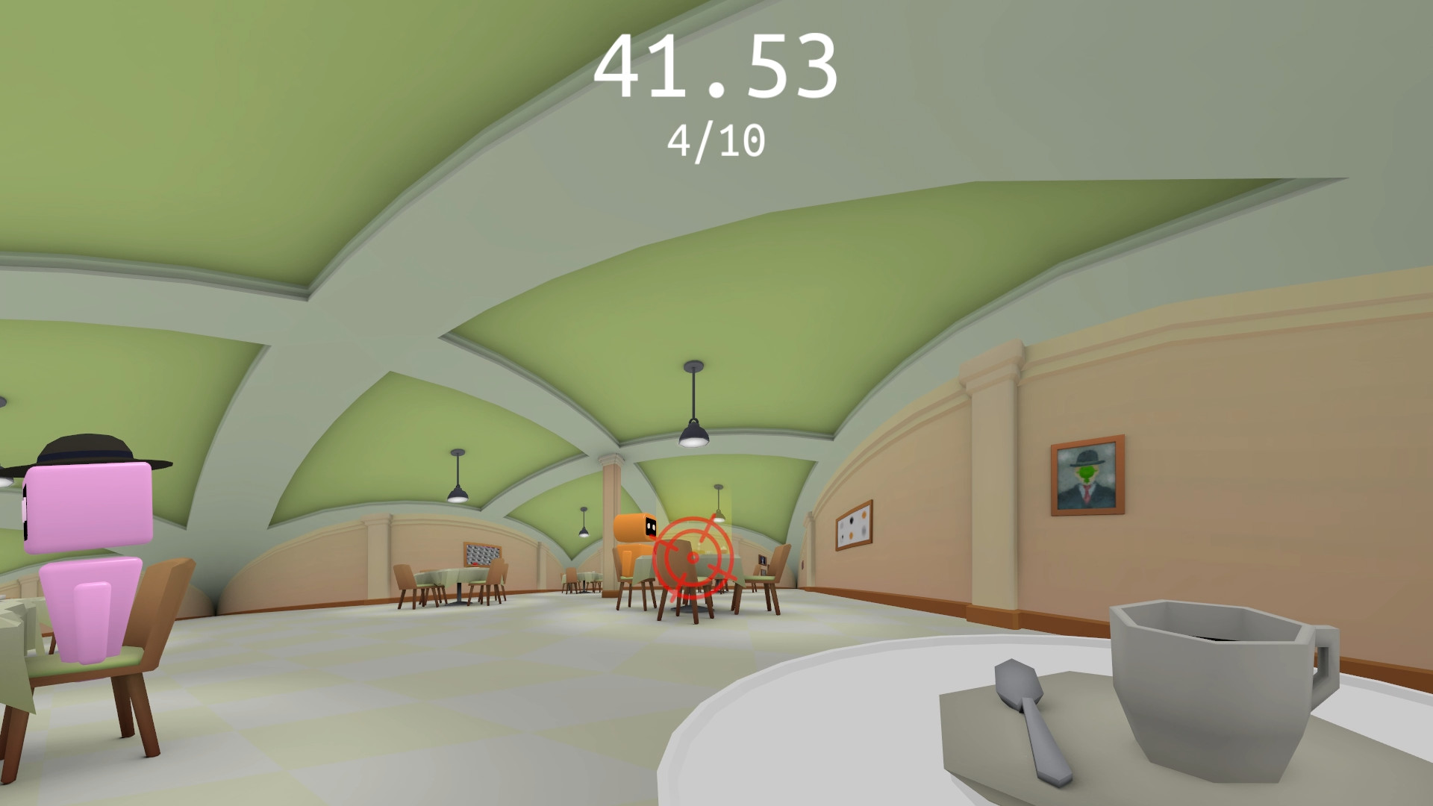
Requirements
Game Engine
Render Non-Euclidean geometry
Run at >30 Frames per second
Target personal (low-end) laptops
Provide intuitive API for external game development
Game Design
Interesting game mechanics
Smooth gameplay
Runs on engine
Figure 5: Screenshot from Hyperbolica.
| Project Overview
| Lights Out
| Non-Euclidean Game
Figure 6: Hollow Knight visual, known for its incredible game design.
Notes:
Taz

Slide 8
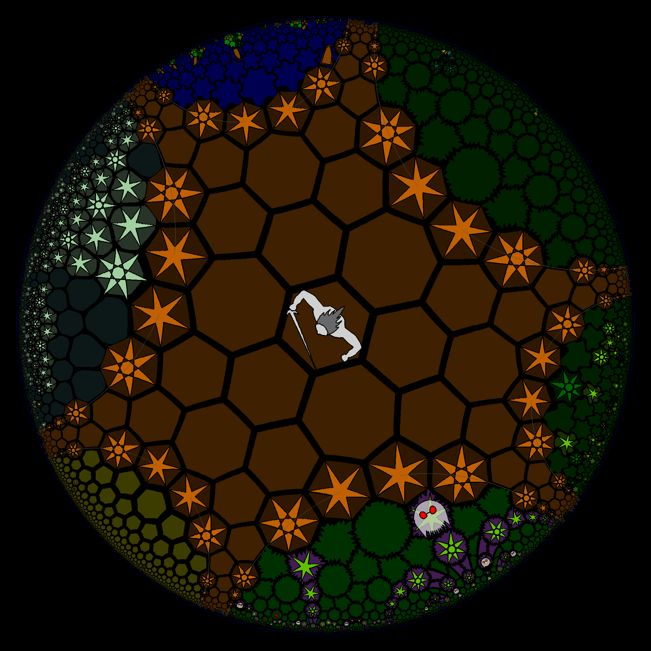
Related Works
HyperRogue
Turn-based world in hyperbolic geometry
Made for research purposes
Hyperbolica
Open world game
Puzzles, games, and quests
Unity
Popular game engine
Only has Euclidean based geometry
Figure 7: HyperRogue render with projection warping.
| Project Overview
| Lights Out
| Non-Euclidean Game
Notes:
Spencer

Slide 9
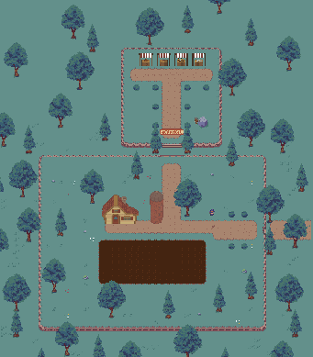
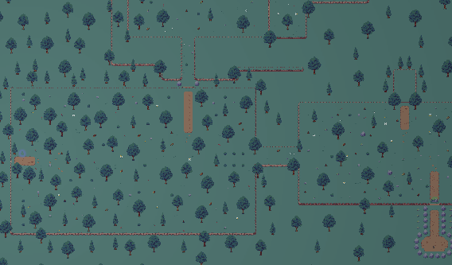
Game Concept – Lights Out
Exploration Focused (2 Areas)
Emphasize Non-Euclidean warping
Plot
Visiting missing grandfather’s farm
Avoid monsters while trying to find him
Main Mechanics
Exploration & Discovery
Farming
Lantern & Trap Placement
NPC interaction
Figure 8: Farm Scene
| Project Overview
| Lights Out
| Non-Euclidean Game
Figure 9: Forest Scene
Notes:
Spencer

Slide 10
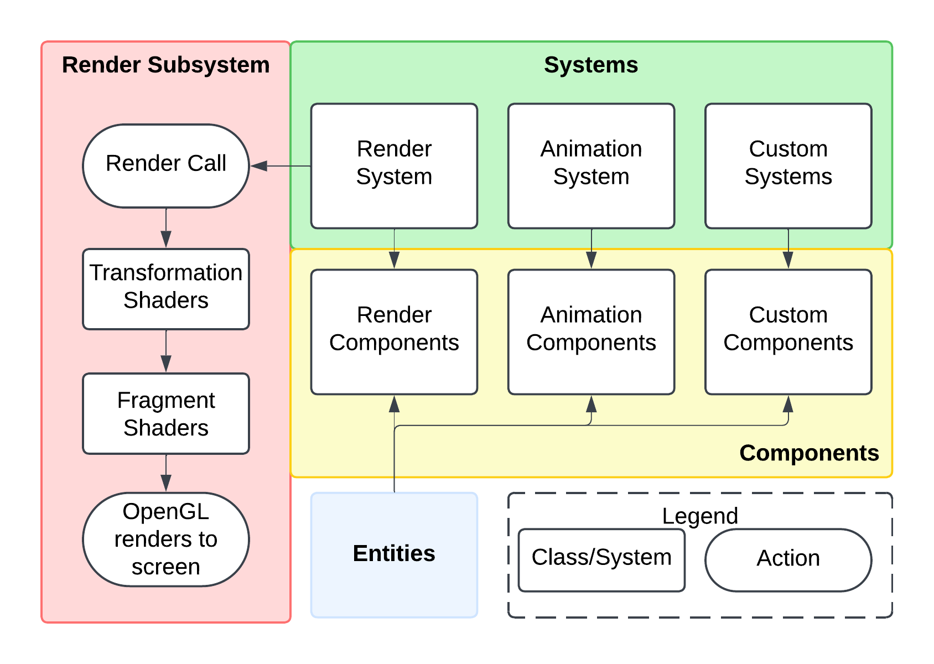
Detailed Design – Engine
The Engine boils down to a System Scheduler, Resource Manager, and Component Registry.
System Scheduler - orders timing and dependencies of systems
Resource Manager - controls globally unique resources (i.e., window)
Component Registry - handles entities & components, provided by EnTT
| Project Overview
| Lights Out
| Non-Euclidean Game
Figure 11: Example Entity-Component- System Architecture
Figure 10: High-Level Overview of Game Engine Operation
Notes:
Ben
If you click on image, it will send you to full image

Slide 11
Implementation
| sdmay25-37

Slide 12
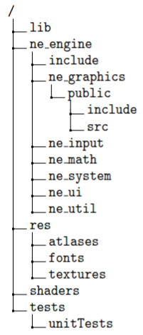
Engine Overview
Followed common practices for game engine development:
Entity-Component-System architecture
Toolchain supports modular and scalable code
Custom Non-Euclidean Shaders
Custom shaders fill industry gap and supports low-level shader development
Figure 12: Game Engine Repository Organization
| Project Overview
| Lights Out
| Non-Euclidean Game
Notes:
Ben

Slide 13
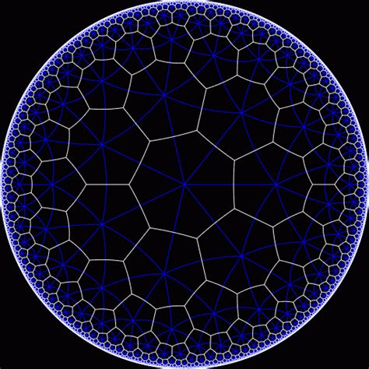
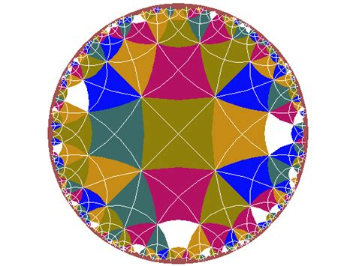
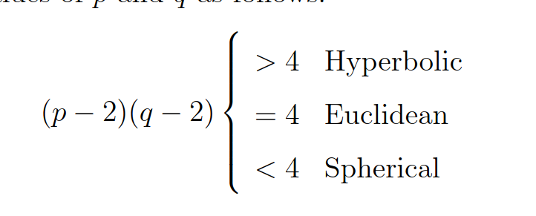
Engine Subcomponent – Hyperbolic Tiling
In order to completely fill a plane, a tiling or tessellation scheme is needed
Depending on the geometry of this plane (spherical, euclidean, hyperbolic) the criterion for the number of corners (p) and number of shapes that meet at a vertex (q) are different
Figure 13: 7-3 Tessellation
| Project Overview
| Lights Out
| Non-Euclidean Game
Figure 14: 4-5 Tessellation
Notes:
Ben

Slide 14
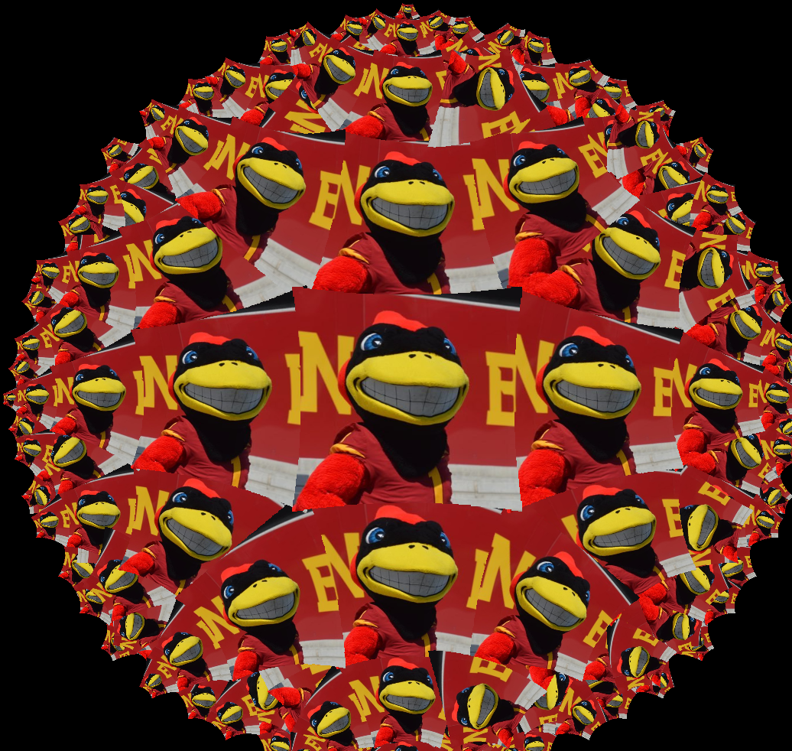
Engine Subcomponent – Hyperbolic Tiling
Steps for Hyperbolic Tiling
Implemented code to generate a 2D representation of a pq tile
pq-tile can be projected to the 3D hyperbolic model
While in the hyperbolic model, a series of rotations on multiple tiles can be performed in order to create a tile map
Projection can then be performed back to 2D for visualization on a screen
Figure 15: Central 4-5 PQ Tile
| Project Overview
| Lights Out
| Non-Euclidean Game
Figure 16: Tiling of CY’s with PQ (4-5) tile
Notes:
Josh

Slide 15
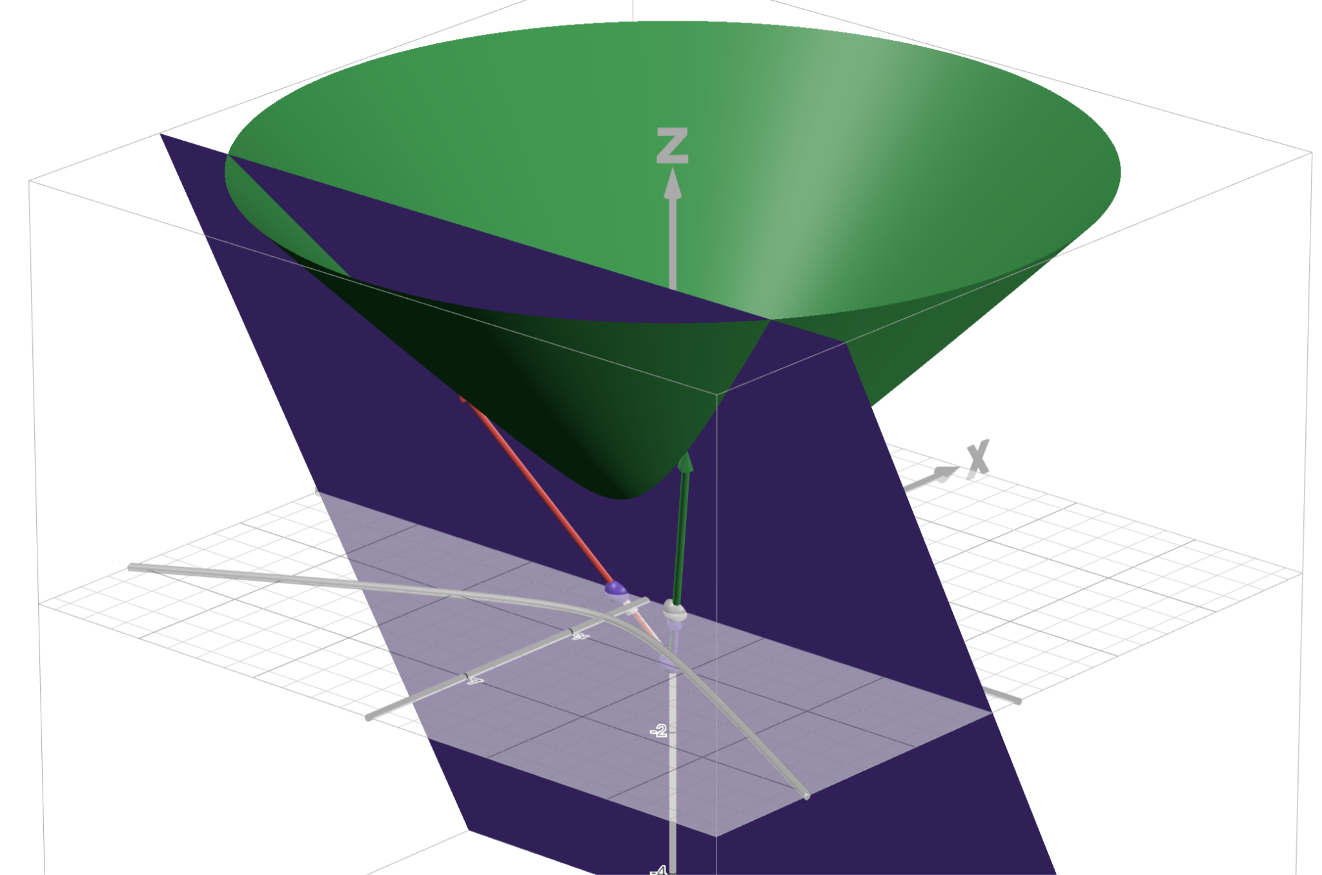
Engine Subcomponent – Math
Projection
Poincare (2D) ➜ Hyperboloid (3D)
Hyperboloid (3D) ➜ Poincare
Hyperbolic Rotation about x (R_{x})
Figure 17: Mapping a Geodesic to the Poincare model
| Project Overview
| Lights Out
| Non-Euclidean Game
Notes:
Josh

Slide 16
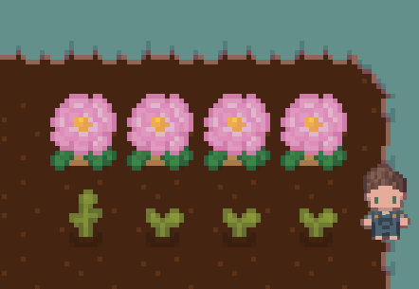
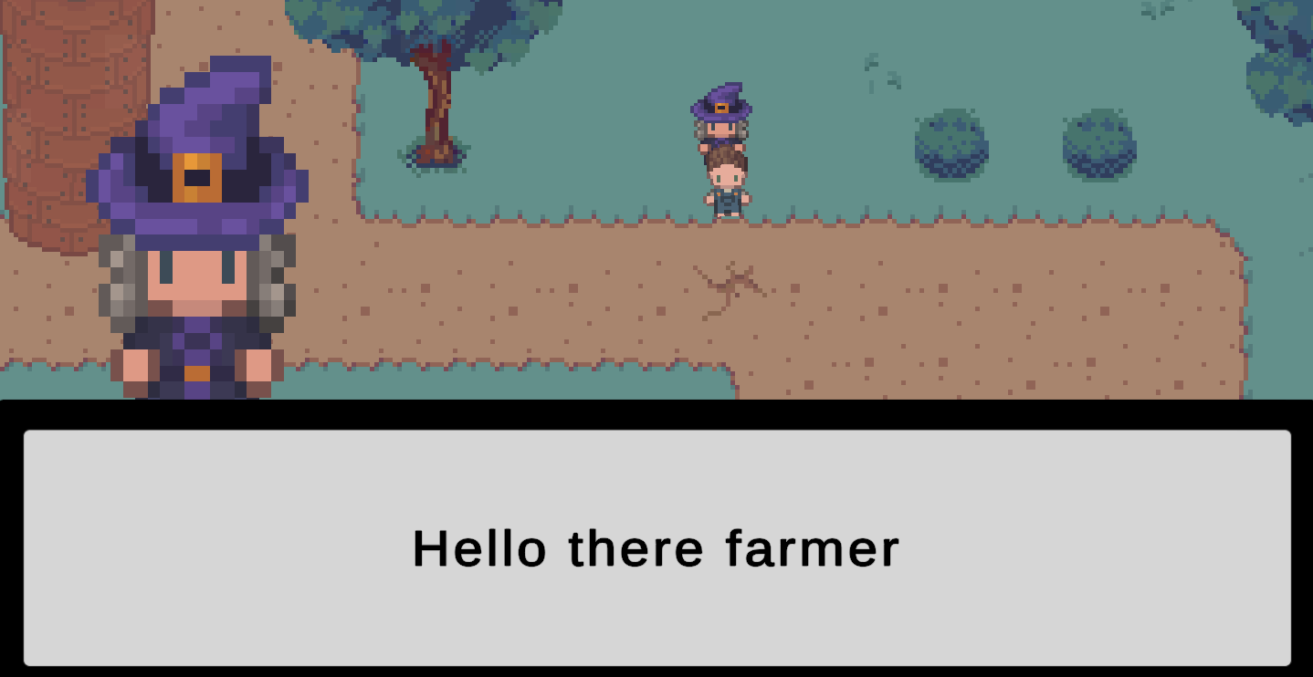
Game Mechanics – Farming/Trading
Farming
Plant and harvest multiple seeds per plant
Random growth time within a predefined range
Seed type determines crop yields
Figure 18: Planting Scene
Non-Player-Characters (NPCs)
Provides helpful tips to progress the story
Trader for services essential for progression
Figure 19: NPC Interaction
Trading
Seeds are used as a form of currency
Trade seeds for buffs (e.g., running faster, better crop yield)
| Project Overview
| Lights Out
| Non-Euclidean Game
Figure 20: Trading Scene
Notes:
Lincoln

Slide 17
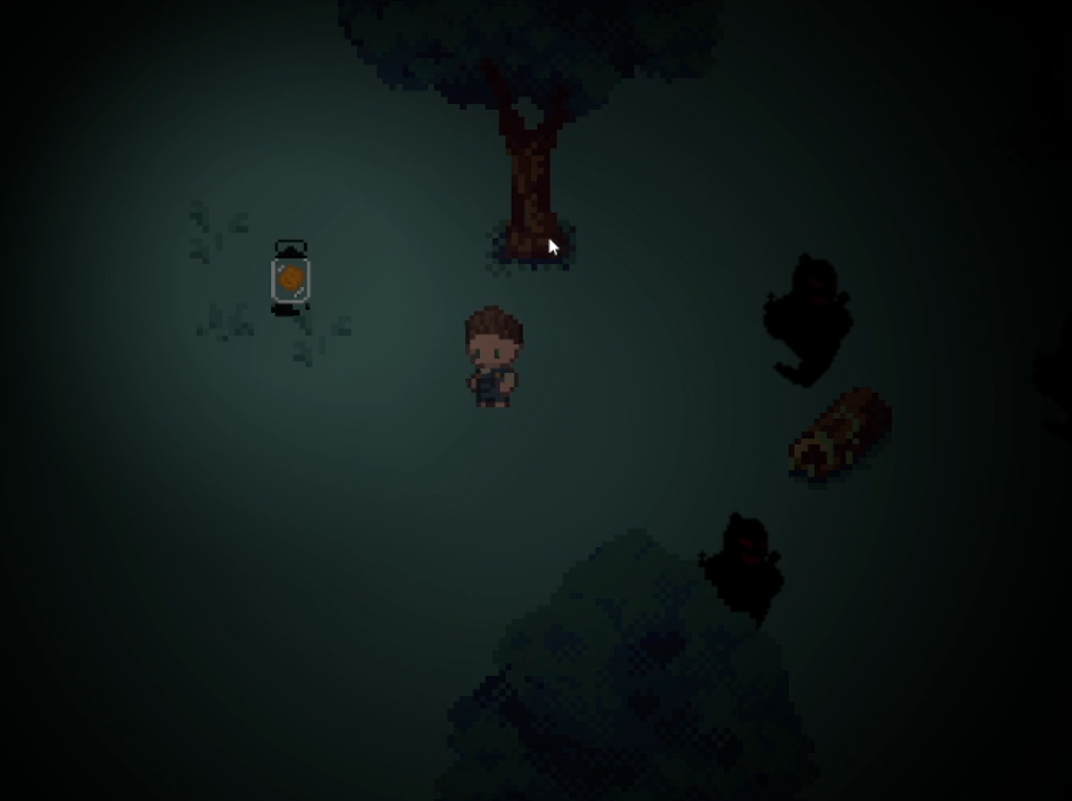
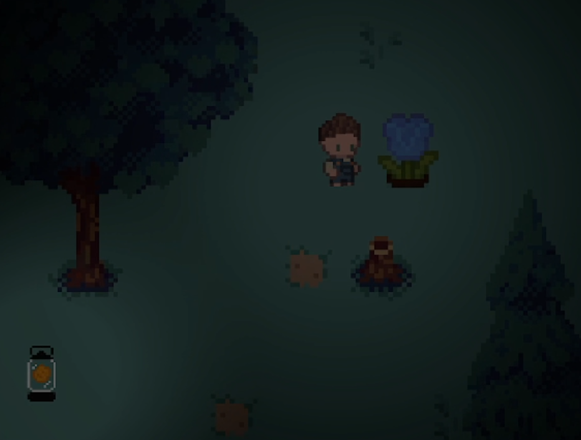
Game Mechanics – Exploration
Enemy AI uses a lightweight FSM with custom A* pathfinding to avoid light and hunt the player
Lighted areas act as dynamic danger areas
Enemies steer clear
Players use them to escape
Players explore the forest for rare seeds that can be…
Grown into unique plants
Traded in the market for items
Used to progress towards the end of the game
Figure 21: Forest scene with enemies and lanterns to ward enemies away
| Project Overview
| Lights Out
| Non-Euclidean Game
Figure 22: Flowers foraged in the forest
Notes:
Lincoln

Slide 18
Playtest - User Testing
Implementation
Itch.io build
General guide document
Google Feedback survey
Figure 23: Itch.io QR
Issues
Enemies were easily avoidable
Interactions are unclear
Accidental inputs were frequent
Potential Solutions
Randomize enemy spawns
Add visual indicators
Separate interactions to different inputs
| Project Overview
| Lights Out
| Non-Euclidean Game
Notes:
Zach

Slide 19
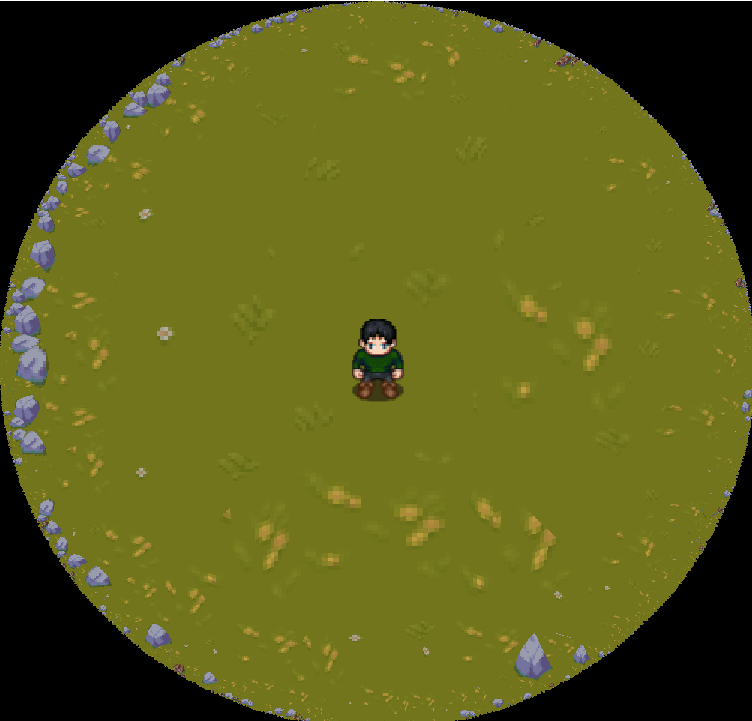
Integration of Engine and Game
Early porting process
Prioritized forest/maze scene
Emphasized Non-Euclidean aspect
Primarily tested engine performance and feasibility of tile map (creating and rendering)
Current issue: converting tile maps from the Unity prototype to custom tile map solution.
Existing conversions are time intensive (manual creation) or memory intensive (python scripting).
Figure 24: Forest/Maze on Non-Euclidean Engine
| Project Overview
| Lights Out
| Non-Euclidean Game
Notes:
Zach

Slide 20
Conclusions
| sdmay25-37

Slide 21
Summary of Work
Game Engine
Built up engine from scratch with the majority of functionality necessary for game development
Includes Input Handling, System Scheduling, Rendering Loop, Non-Euclidean Shaders, Tilemaps, etc.
Game Design
Design and iteration process was repeatedly undergone through the use of a Unity Prototype
Playtesting to receive feedback on gameplay mechanics before transitioning to our engine
| Project Overview
| Lights Out
| Non-Euclidean Game
Notes:
Cory

Slide 22
Future Plans
Polish Engine
Performance Optimization
Intuitive API Design
Improve Non Euclidean Map Generation
Continue Integrating Unity Demo with Engine
More Areas and Mechanics
Flesh out in-game story
Finish / Continue Non-Euclidean Shaders
Add other tessellations
| Project Overview
| Lights Out
| Non-Euclidean Game
Notes:
Cory

Slide 23
Demos
| sdmay25-37

Slide 24
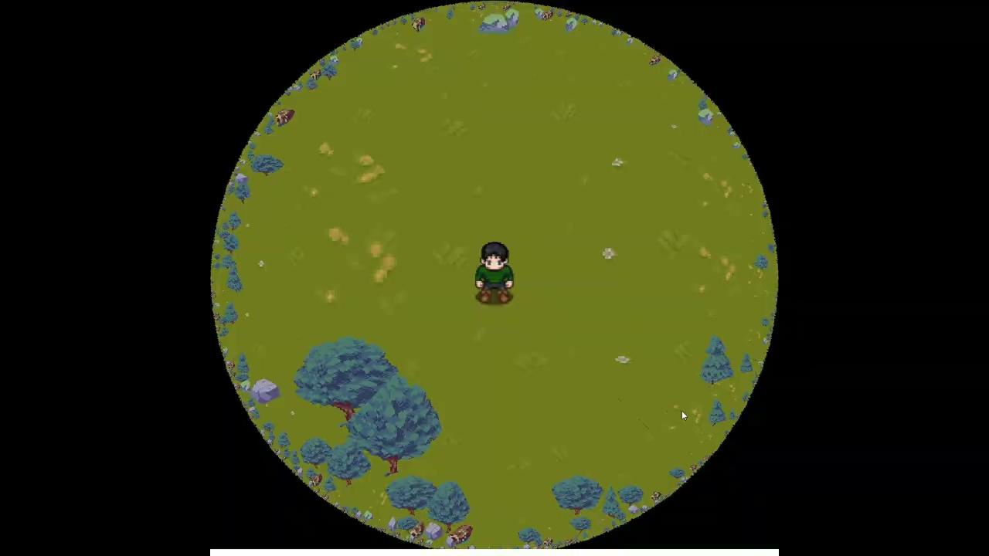
Non Euclidean Engine Demo
| Project Overview
| Lights Out
| Non-Euclidean Game
Notes:
Cory

Slide 25
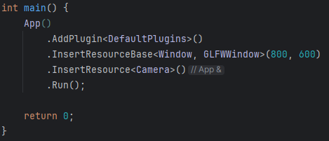
Engine How to Use - Example
1. Create our App in main
2. Add the default plugins.
Give it a window and camera.
| Project Overview
| Lights Out
| Non-Euclidean Game
Notes:
Ben

Slide 26
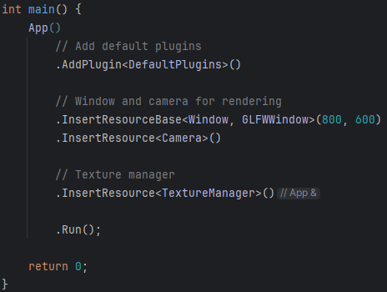
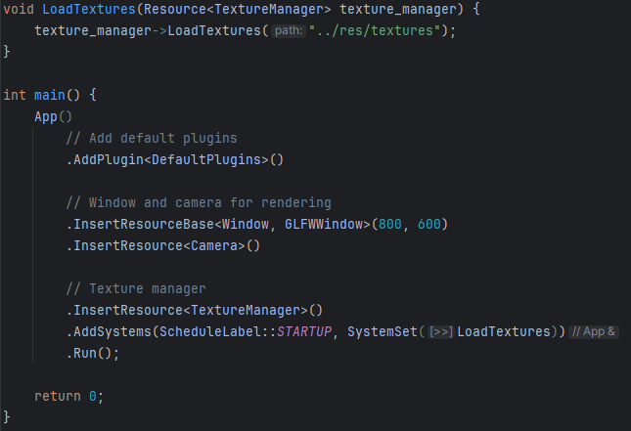
Engine How to Use - Example
3. Add a texture manager
4. Create a system to load textures on startup
| Project Overview
| Lights Out
| Non-Euclidean Game
Notes:
Ben

Slide 27
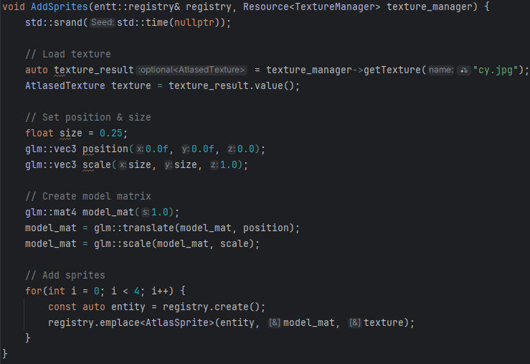
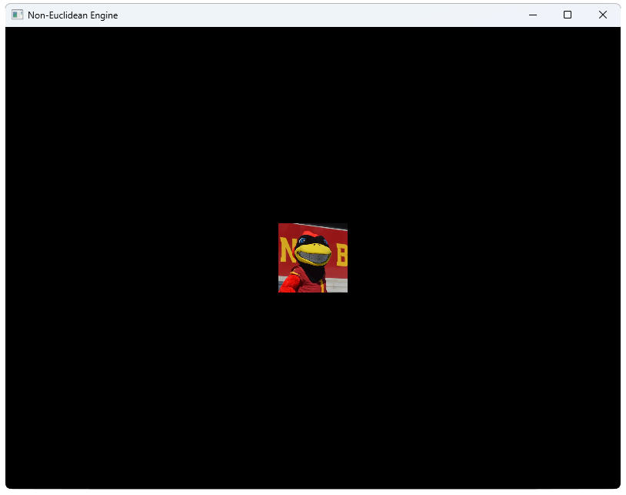
Engine How to Use - Example
5. Create a system to add sprites
6. Add it to the App
| Project Overview
| Lights Out
| Non-Euclidean Game
Notes:
Ben

Slide 28
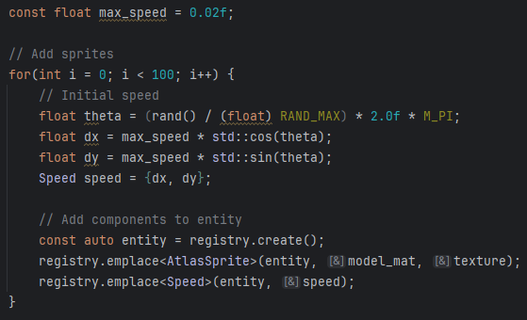
Engine How to Use - Example
7. Create a custom component
8. Add it to the sprites
| Project Overview
| Lights Out
| Non-Euclidean Game
Notes:
Ben

Slide 29
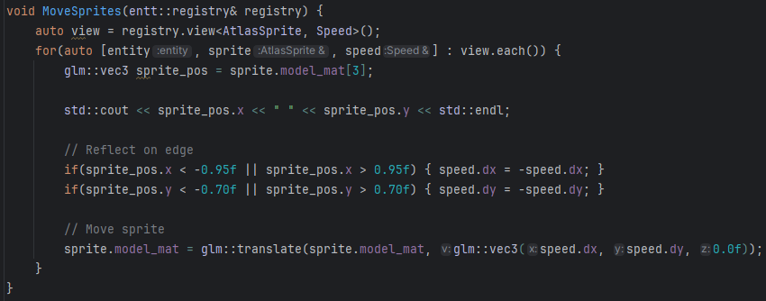
Engine How to Use - Example
9. Create a system to move the sprites
10. Add it to the App
| Project Overview
| Lights Out
| Non-Euclidean Game
Notes:
Ben

Slide 30
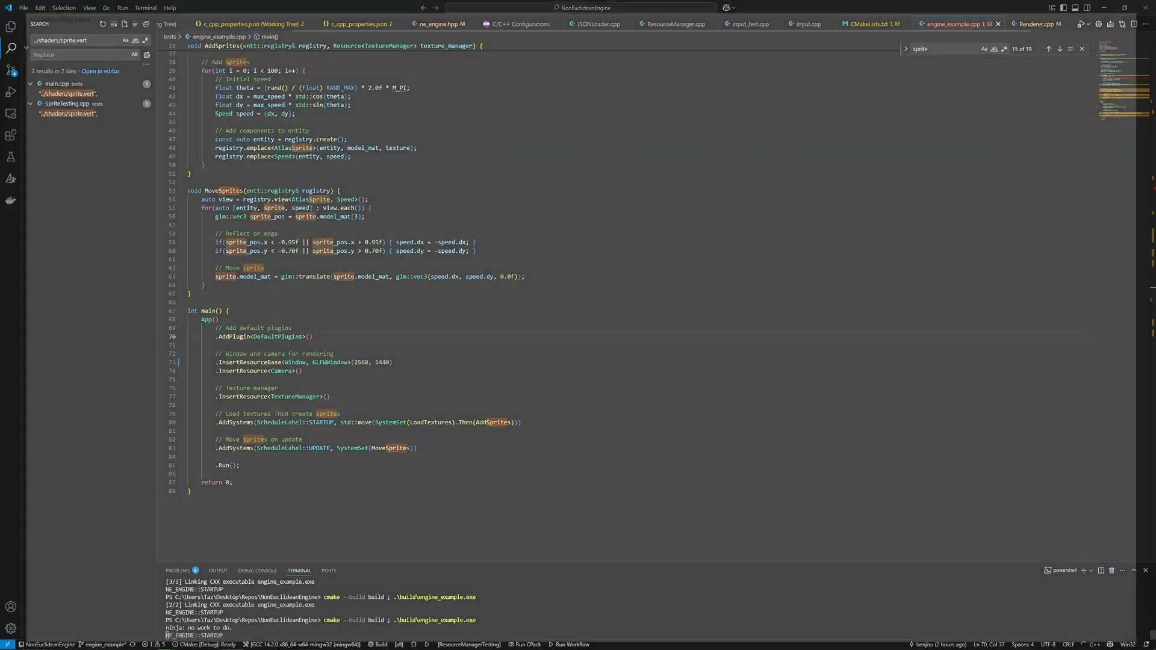
Engine How to Use - Example
RELEASE THE CYS
| Project Overview
| Lights Out
| Non-Euclidean Game
Notes:
Ben

Slide 31
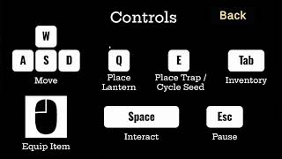
Euclidean Unity Demo
| Project Overview
| Lights Out
| Non-Euclidean Game
Notes:
Spencer

Slide 32
Appendix
| sdmay25-37

Slide 33
High-Level Engine Operation
| Project Overview
| Lights Out
| Non-Euclidean Game
Notes:
Taz

Slide 34
Example ECS Architecture Figure
| Project Overview
| Lights Out
| Non-Euclidean Game
Notes:
Taz

Slide 35
Engine Overview
Entity-Component-System Architecture
Core Functional Units
Graphics – UI and OpenGL
System Update/Processing Loop
EnTT – Entity-Component System
Toolchain
CMake Compilation
Static Library Linking
CTest Unit Testing with Catch2
External Libraries
Third Party Library Integration (e.g., EnTT, STB Image, and more)
Figure: Game Engine Repository Organization
| Project Overview
| Lights Out
| Non-Euclidean Game

Slide 36
Engine Subcomponent - Toolchain
CMake
Compiles and Links Resources, Libraries, and Source Code
Allows for simple compilation and a scalable repository
CTest
Unit Testing performed with Catch2 and CTest
Macro-heavy and intuitive testing framework
IMGui
GUI-based Library used as a developer editor for visually creating Texture Atlases, Animations, and Key Mappings
Intended as an accessible way to configure sprites and inputs
| Project Overview
| Lights Out
| Non-Euclidean Game

Slide 37
Engine Subcomponent - Entity-Component-System (ECS)
Implemented EnTT as our ECS
Provides an efficient backend for component storage querying
An ECS system requires of data structures not common in many applications
EnTT is a well-known, open-source implementation provided by the community
How Does it Work?
Entities store unique components
Users iterate over components not entities
Keeps functionality localized
Figure: EnTT Library Logo
| Project Overview
| Lights Out
| Non-Euclidean Game
Notes:
Ben

Slide 38
Game Design Creation
Spent the initial weeks ideating
Individual brainstorming
Fleshing out ideas into fuller game concepts
Met with the whole team to decide what idea was best
Chose Lights Out, an exploration game with farming and horror elements
Refined game concept
Listed potential game mechanics and their priority level
Developed a narrative background and character concepts
Decided on initial development tasks
| Project Overview
| Lights Out
| Non-Euclidean Game

Slide 39
Game Overview
Core Functionality
Farming and Trading
Exploration and Foraging
Toolchain
Unity
Composition Focused
Github
Adjusted git.ignore and workflow to fit Unity
Necessary to handle the large amount of non-essential data unity creates at each run
Itch.io
Web host for our Unity prototype
| Project Overview
| Lights Out
| Non-Euclidean Game

Slide 40
Game Concept - Lights Out
Exploration Focused
Emphasize and draw attention to Non-Euclidean aspect
Plot
Visiting your grandfather’s farm after he goes missing
You must explore the forest to find him while avoiding monsters
Main Mechanics
Explore to find and unlock new seeds
Farm to increase seeds and buy tools
Place lanterns and traps to protect yourself
Interact with characters around the farm
| Project Overview
| Lights Out
| Non-Euclidean Game

Slide 41
Iterations of Game Design
Original Version:
Multiple biomes and in-game puzzles planned
More developed interactions with NPCs and overall plot
Supplementary gameplay with crafting and fishing
Quest systems for player objectives
Latest Design Iteration:
Two Biomes: Farm and Forest
Added traps and increased enemy variety
Transitioned from a quest system to true exploration
| Project Overview
| Lights Out
| Non-Euclidean Game
Notes:
Not done here yet, so no hate needed on teh partial

Slide 42
Math Background
| sdmay25-37

Slide 43
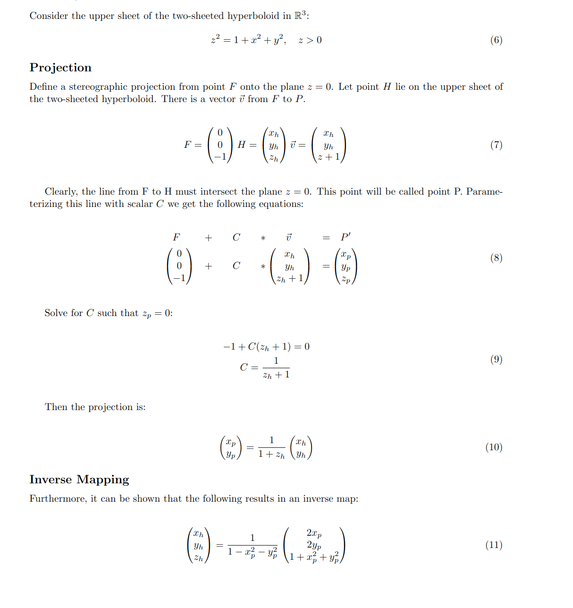
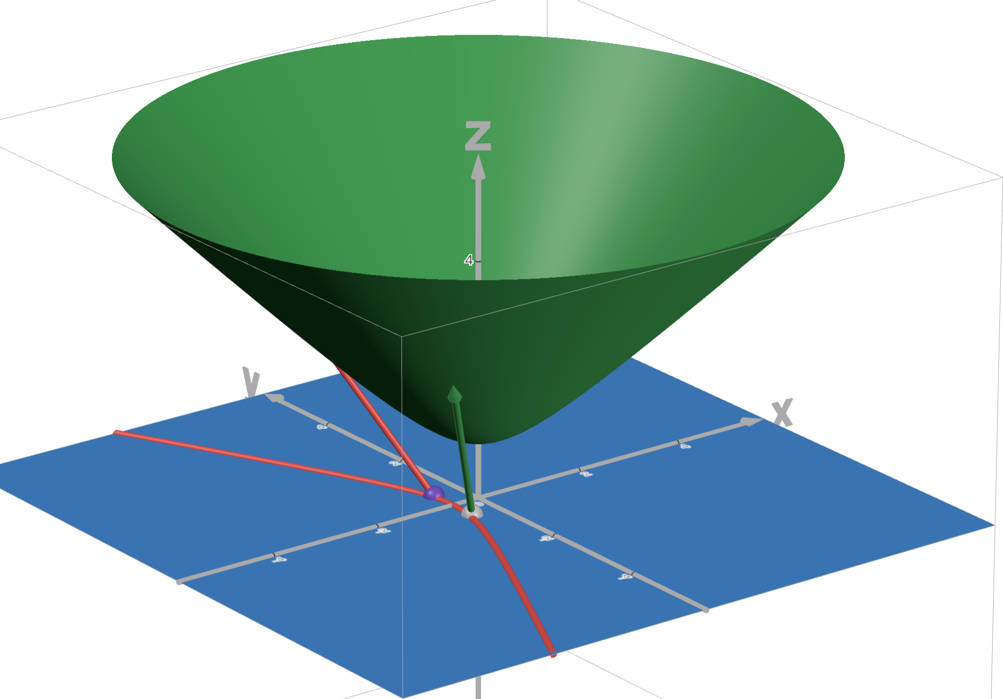
Stereographic Projection Proof
Figure 15
Example Vectors for Projection
| Project Overview
| Lights Out
| Non-Euclidean Game
Notes:
Josh

Slide 44
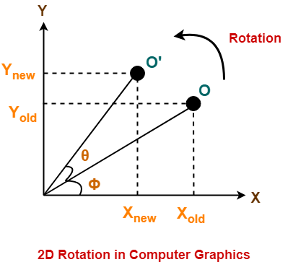
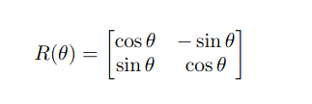
What is a Rotation
A rotation preserves both a distance(norm) and angle between points in the same space
In Euclidean Space the norm is given by Pythagorean Theorem:
The standard rotation matrix in Euclidean Space is as follows:
Figure X
Rotating a Point with a Standard Euclidean Rotation
| Project Overview
| Lights Out
| Non-Euclidean Game
Notes:
Josh

Slide 45
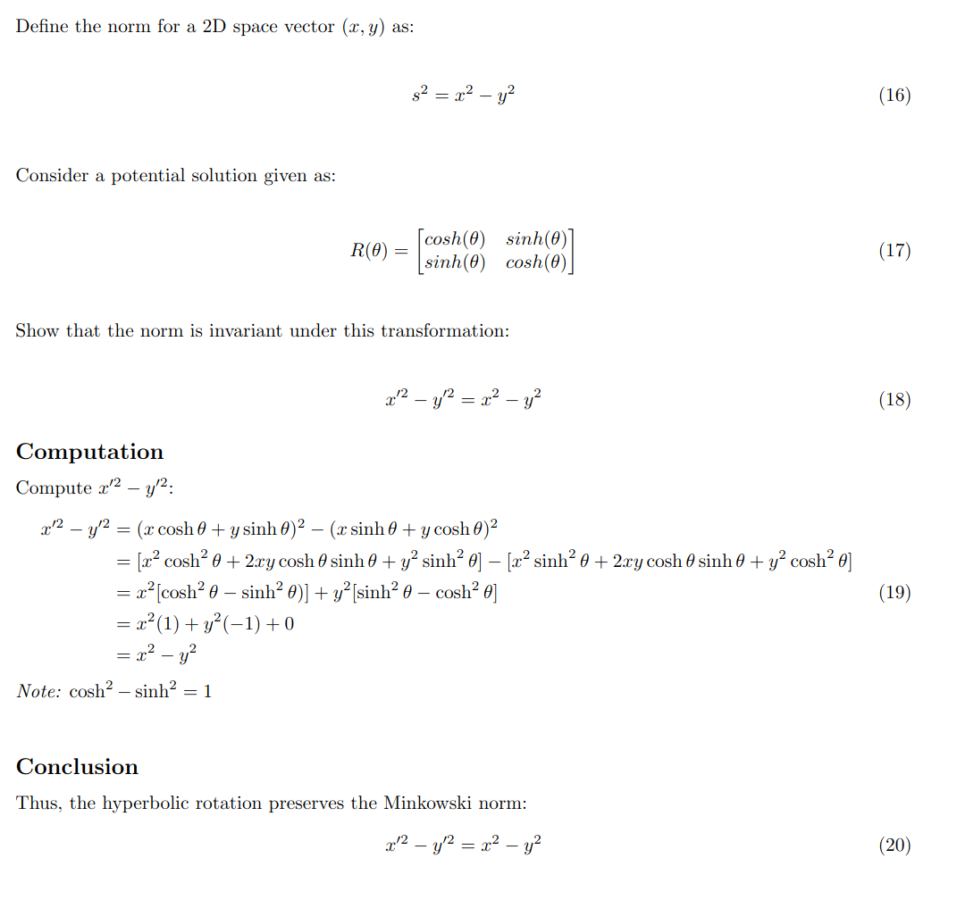
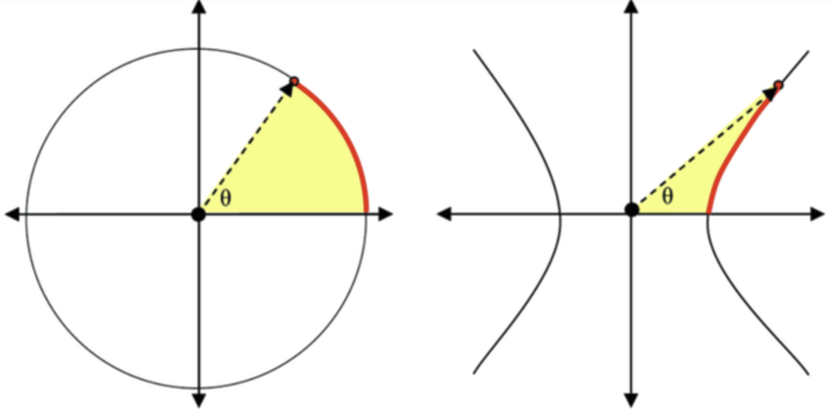
Hyperbolic Rotation Proof
| Project Overview
| Lights Out
| Non-Euclidean Game
Notes:
Josh

Slide 46
Slide Graveyard
| sdmay25-37

Slide 47
Engine Overview
Entity-Component-System Architecture
Core Functional Units
Graphics – UI and OpenGL
System Update/Processing Loop
EnTT – Entity-Component System
Toolchain
CMake Compilation
Static Library Linking
CTest Unit Testing with Catch2
External Libraries
Third Party Library Integration (e.g., EnTT, STB Image, and more)
Figure X: Game Engine Repository Organization
| Project Overview
| Lights Out
| Non-Euclidean Game

Slide 48
Iterations of Game Design
Brainstormed individual ideas
Brainstorming/ Fleshing out different ideas
| Project Overview
| Lights Out
| Non-Euclidean Game
Notes:
Taz

Slide 49
Game Concept
Bullet Points explaining our lights out game
Main Mechanics
Main style of game
Story
| Project Overview
| Lights Out
| Non-Euclidean Game
Notes:
Taz

Slide 50
Iterations of Game Design
Slide about initial design of lights out
Talk about important changes that have been made
Mult biomes originally - been cut back (dropped blue light biome)
Transitioned the forest to more of a maze
Added traps - was not originally planned
Key Decisions - maybe combine this with the key decisions section
Decrease in scale
Issues - not able to completely port over to engine yet
Maybe include an initial prototype/ demo from end of semester 1
we can, but might not have the time to actually show it (would rather spend the time showing a sem 2 demo instead)
| Project Overview
| Lights Out
| Non-Euclidean Game
Notes:
Not done here yet, so no hate needed on teh partial

Slide 51
Game Mechanics - Farming/Trading
Farming
Plant seeds to harvest them later for greater amounts
Random growth time within a predefined range
Seed type determines crop yields
Trading
Seeds are used as a form of currency
Trade seeds for useful effects like running faster or better crop yields
NPCs
Provide helpful tips to progress the story
One is tradeable with and is essential for game progression
| Project Overview
| Lights Out
| Non-Euclidean Game

Slide 52
Game Design Creation
Spent the initial weeks ideating
Individual brainstorming
Fleshing out ideas into fuller game concepts
Met with the whole team to decide what idea was best
Chose Lights Out, an exploration game with farming and horror elements
Refined game concept
Listed potential game mechanics and their priority level
Developed a narrative background and character concepts
Decided on initial development tasks
| Project Overview
| Lights Out
| Non-Euclidean Game

Slide 53
Game Design
Iterative design process
Latest Iteration:
Reduced Scope
Two Areas: Farm and Forest
Added traps and increased enemy variety
Transitioned from a quest system to true exploration
Figure 10: Farm Scene
| Project Overview
| Lights Out
| Non-Euclidean Game
Figure 11: Forest Scene
Notes:
Not done here yet, so no hate needed on teh partial

Slide 54
Playtest
Implementation
Itch.io build
General guide document
Google Feedback survey
Pros/Likes
Plant harvesting
Equipment boosts
In depth but not long
Bugs/suggestions
Plant permanence is finicky
Add visual indicator for trades (currently use audible indicators)
Separate pick up and plant buttons
Better NPC dialogue about game objectives/goals
Improve enemies (variety/spawn location)
| Project Overview
| Lights Out
| Non-Euclidean Game
Notes:
Zach

