Slide 1

Faculty Presentation
Non-Euclidean Game - Lights Out
Project Members: Tasman Grinnell, Ben Johnson, Josh Deaton
Cory Roth, Zach Rapoza, Spencer Thiele, Lincoln Kness
Advisor: Dr. Joseph Zambreno
Client: Josh Deaton
| sdmay25-37
Notes:
Introduce Everyone
Add captions for each of the images

Slide 2

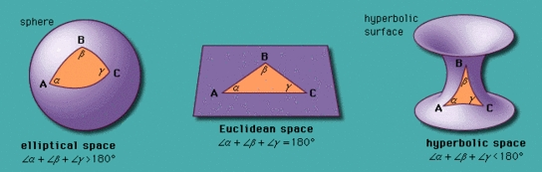
Project Overview
This project aims to:
Create a Non-Euclidean 2-dimensional game/rendering engine
Design and develop a game to showcase the engine
| Project Overview
| Lights Out
| Non-Euclidean Game
Figure 1: Overview of Euclidean versus Non-Euclidean Spaces.
FACULTY PRESENTATION | 2
Notes:
Taz

Slide 3
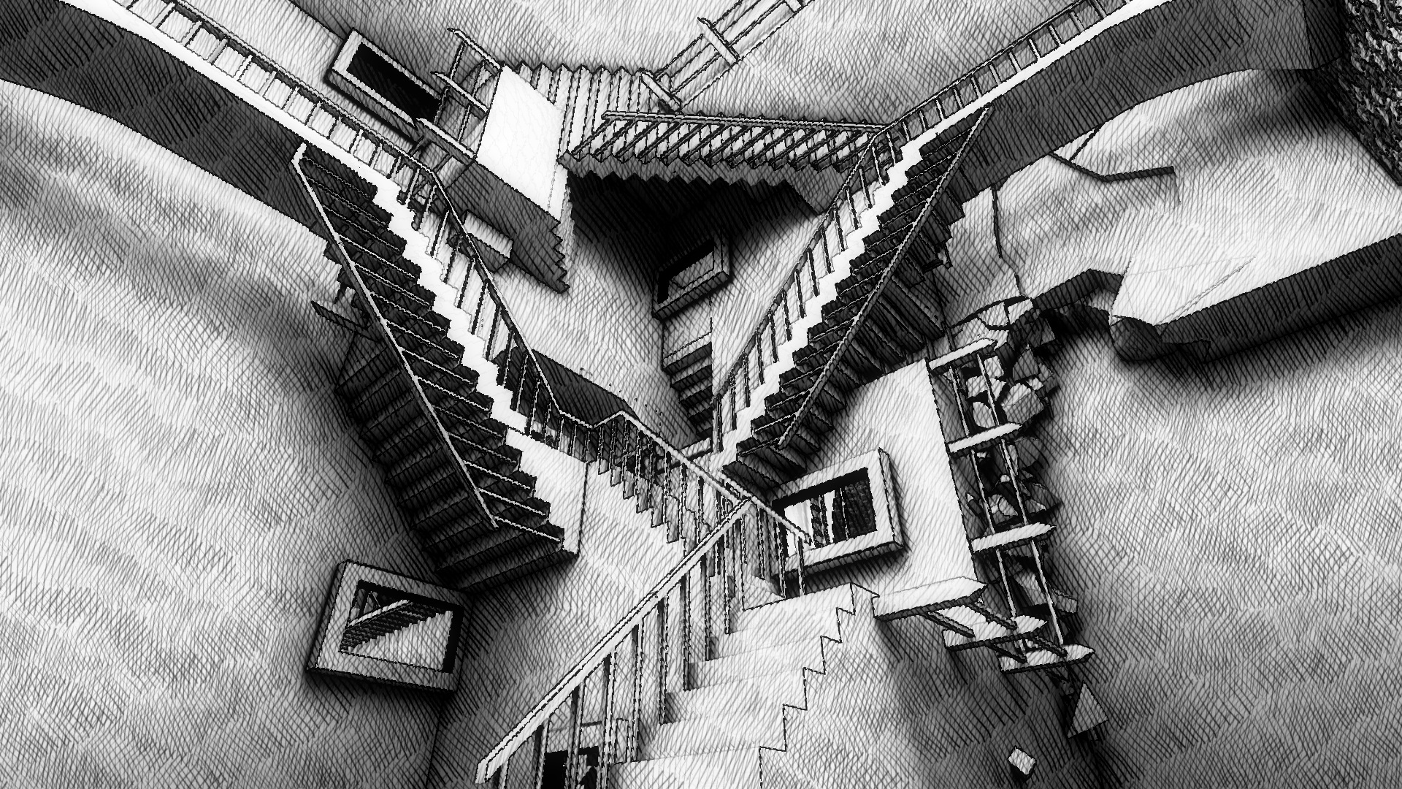
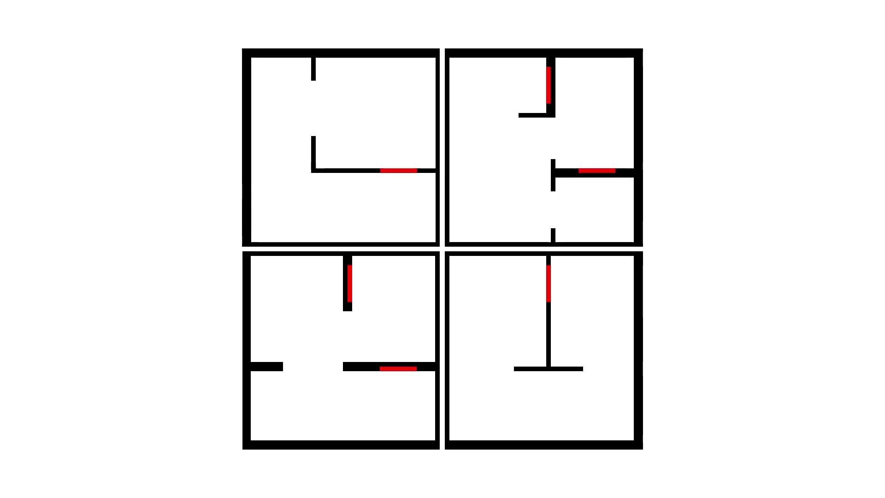
Problem Statement
Current State of Non-Euclidean games:
Limits in rendering techniques
Primary focus in experimentation or research
Many “Non-Euclidean” Games use tricks
Goal:
Build a Non-Euclidean rendering engine and build a entertaining
game on top of the engine.
Figure 2: Example of fake Non-Euclidean world (Euclid’s Fragments).
| Project Overview
| Lights Out
| Non-Euclidean Game
Figure 3: Example of fake Non-Euclidean world.
FACULTY PRESENTATION | 3
Notes:
Taz

Slide 4
Agenda . 4
Non-Euclidean Background 5
Project Plan 9
System Design 17
Conclusion 24
Questions 30
| sdmay25-37
Notes:
Taz

Slide 5
Non-Euclidean Background
| sdmay25-37

Slide 6
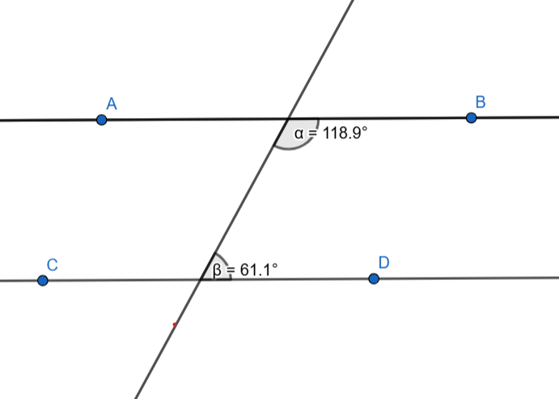
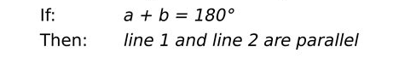
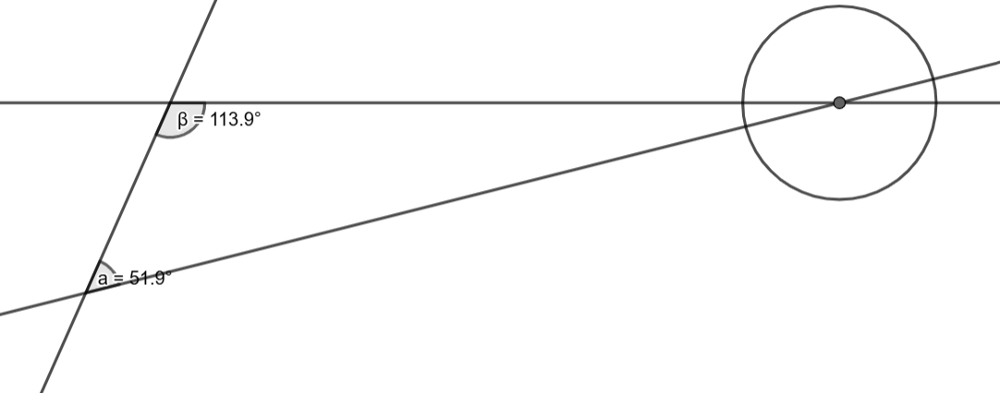
What Is Euclidean Geometry?
5th Euclidean Postulate - Parallel Postulate
If a straight line falling on two straight lines make the interior angles on the same side less than two right angles, the two straight lines, if produced indefinitely, meet on that side on which the angles are less than two right angles.
Figure 4: Complementary angles summing to 180 degrees for parallel lines.
| Non-Euclidean Background
| Lights Out
| Non-Euclidean Game
Figure 5: Complementary angles summing less than 180 degrees (non-parallel).
FACULTY PRESENTATION | 06
Notes:
Josh

Slide 7
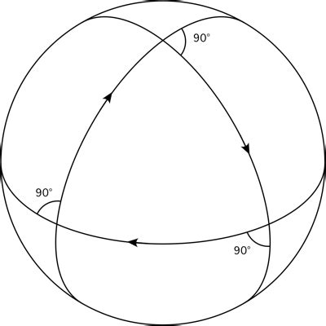
What Is Non-Euclidean Geometry?
Removing Parallel postulate:
Any geometry that removes the parallel postulate is considered Non-Euclidean geometry
Figure 6: Example of a globe hosting triangles with three 90 degree angles.
| Non-Euclidean Background
| Lights Out
| Non-Euclidean Game
FACULTY PRESENTATION | 07
Notes:
Josh

Slide 8
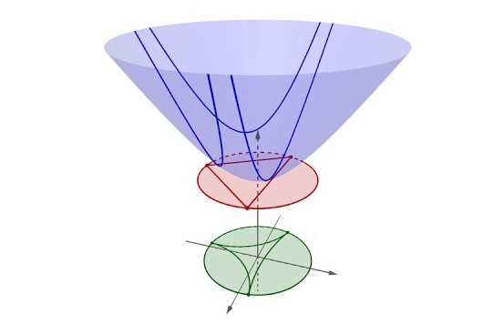

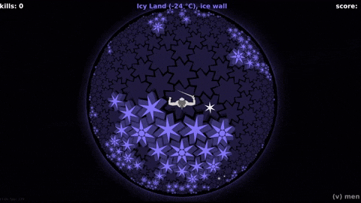
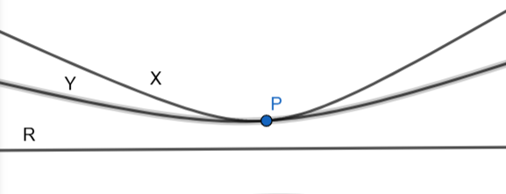
What Is Hyperbolic Geometry?
Introduce new postulate:
Figure 7: Visualization of Poincare Projection from hyperbolic space to a 2-dimensional plane.
| Non-Euclidean Background
| Lights Out
| Non-Euclidean Game
Figure 8: Visualization of new postulate.
FACULTY PRESENTATION | 08
Figure 9: Example Gameplay from HyperRogue.
Notes:
Josh

Slide 9
Project Plan
| sdmay25-37

Slide 10
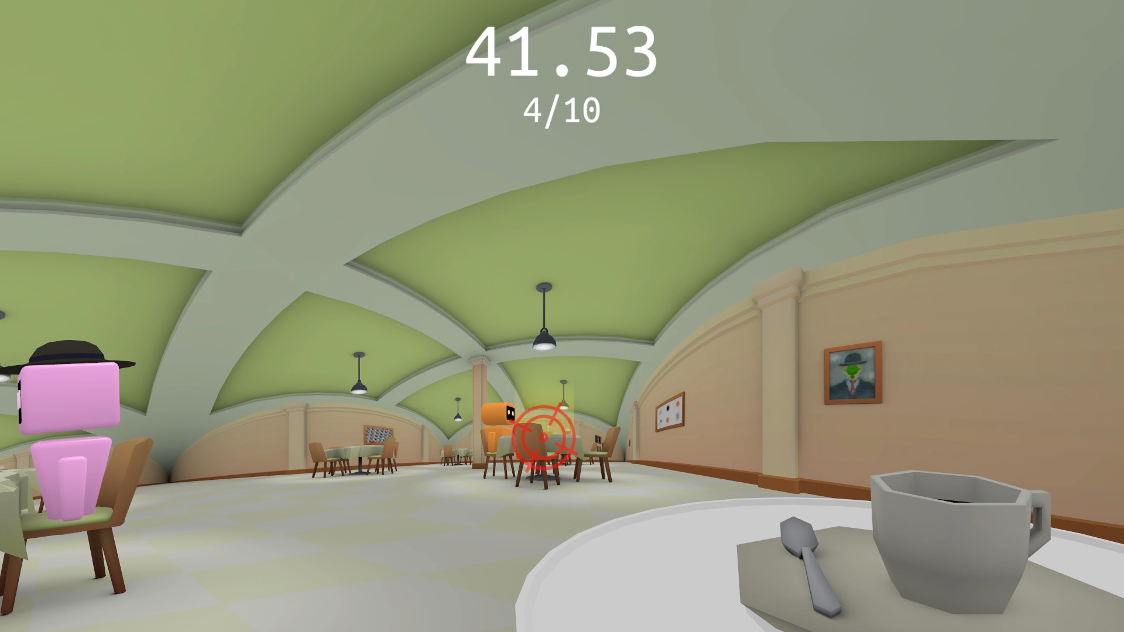

Functional Requirements
Render Engine
Renders Non-Euclidean geometry
Run at 30 fps
Must be usable on personal laptop
Game Design
Interesting game mechanics
Smooth gameplay
Runs on engine
Figure 10: Screenshot from Hyperbolica.
| Project Plan
| Lights Out
| Non-Euclidean Game
Figure 11: Hollow Knight visual, known for its incredible game design.
FACULTY PRESENTATION | 10
Notes:
Taz - Elaborate on the images

Slide 11


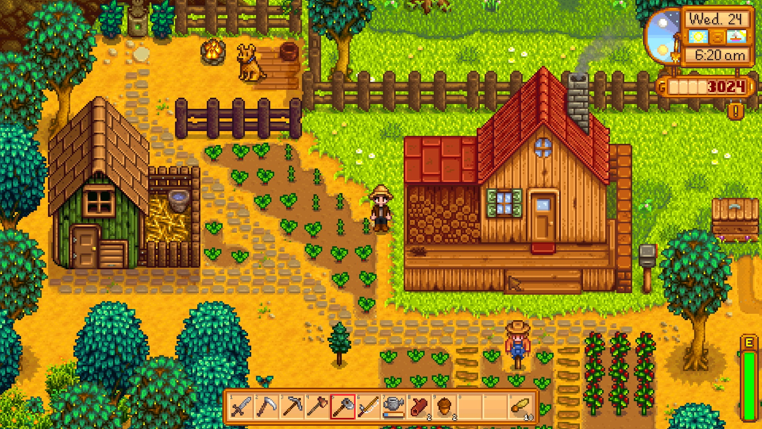
Non-Functional Requirements
Render Engine
Clear external documentation
Usable API for other projects
Easy to Install
Game Design
Intuitive UI
Easy to use controls
Interesting and easy-to-follow story
Visually appealing game
Enjoyable gameplay loop
Figure 12 (above): Mainstream Game Engines (Unreal, Unity).
| Project Plan
| Lights Out
| Non-Euclidean Game
Figure 13: Stardew Valley, a game known for its simplicity and excellent gameplay.
FACULTY PRESENTATION | 11
Notes:
Lincoln

Slide 12
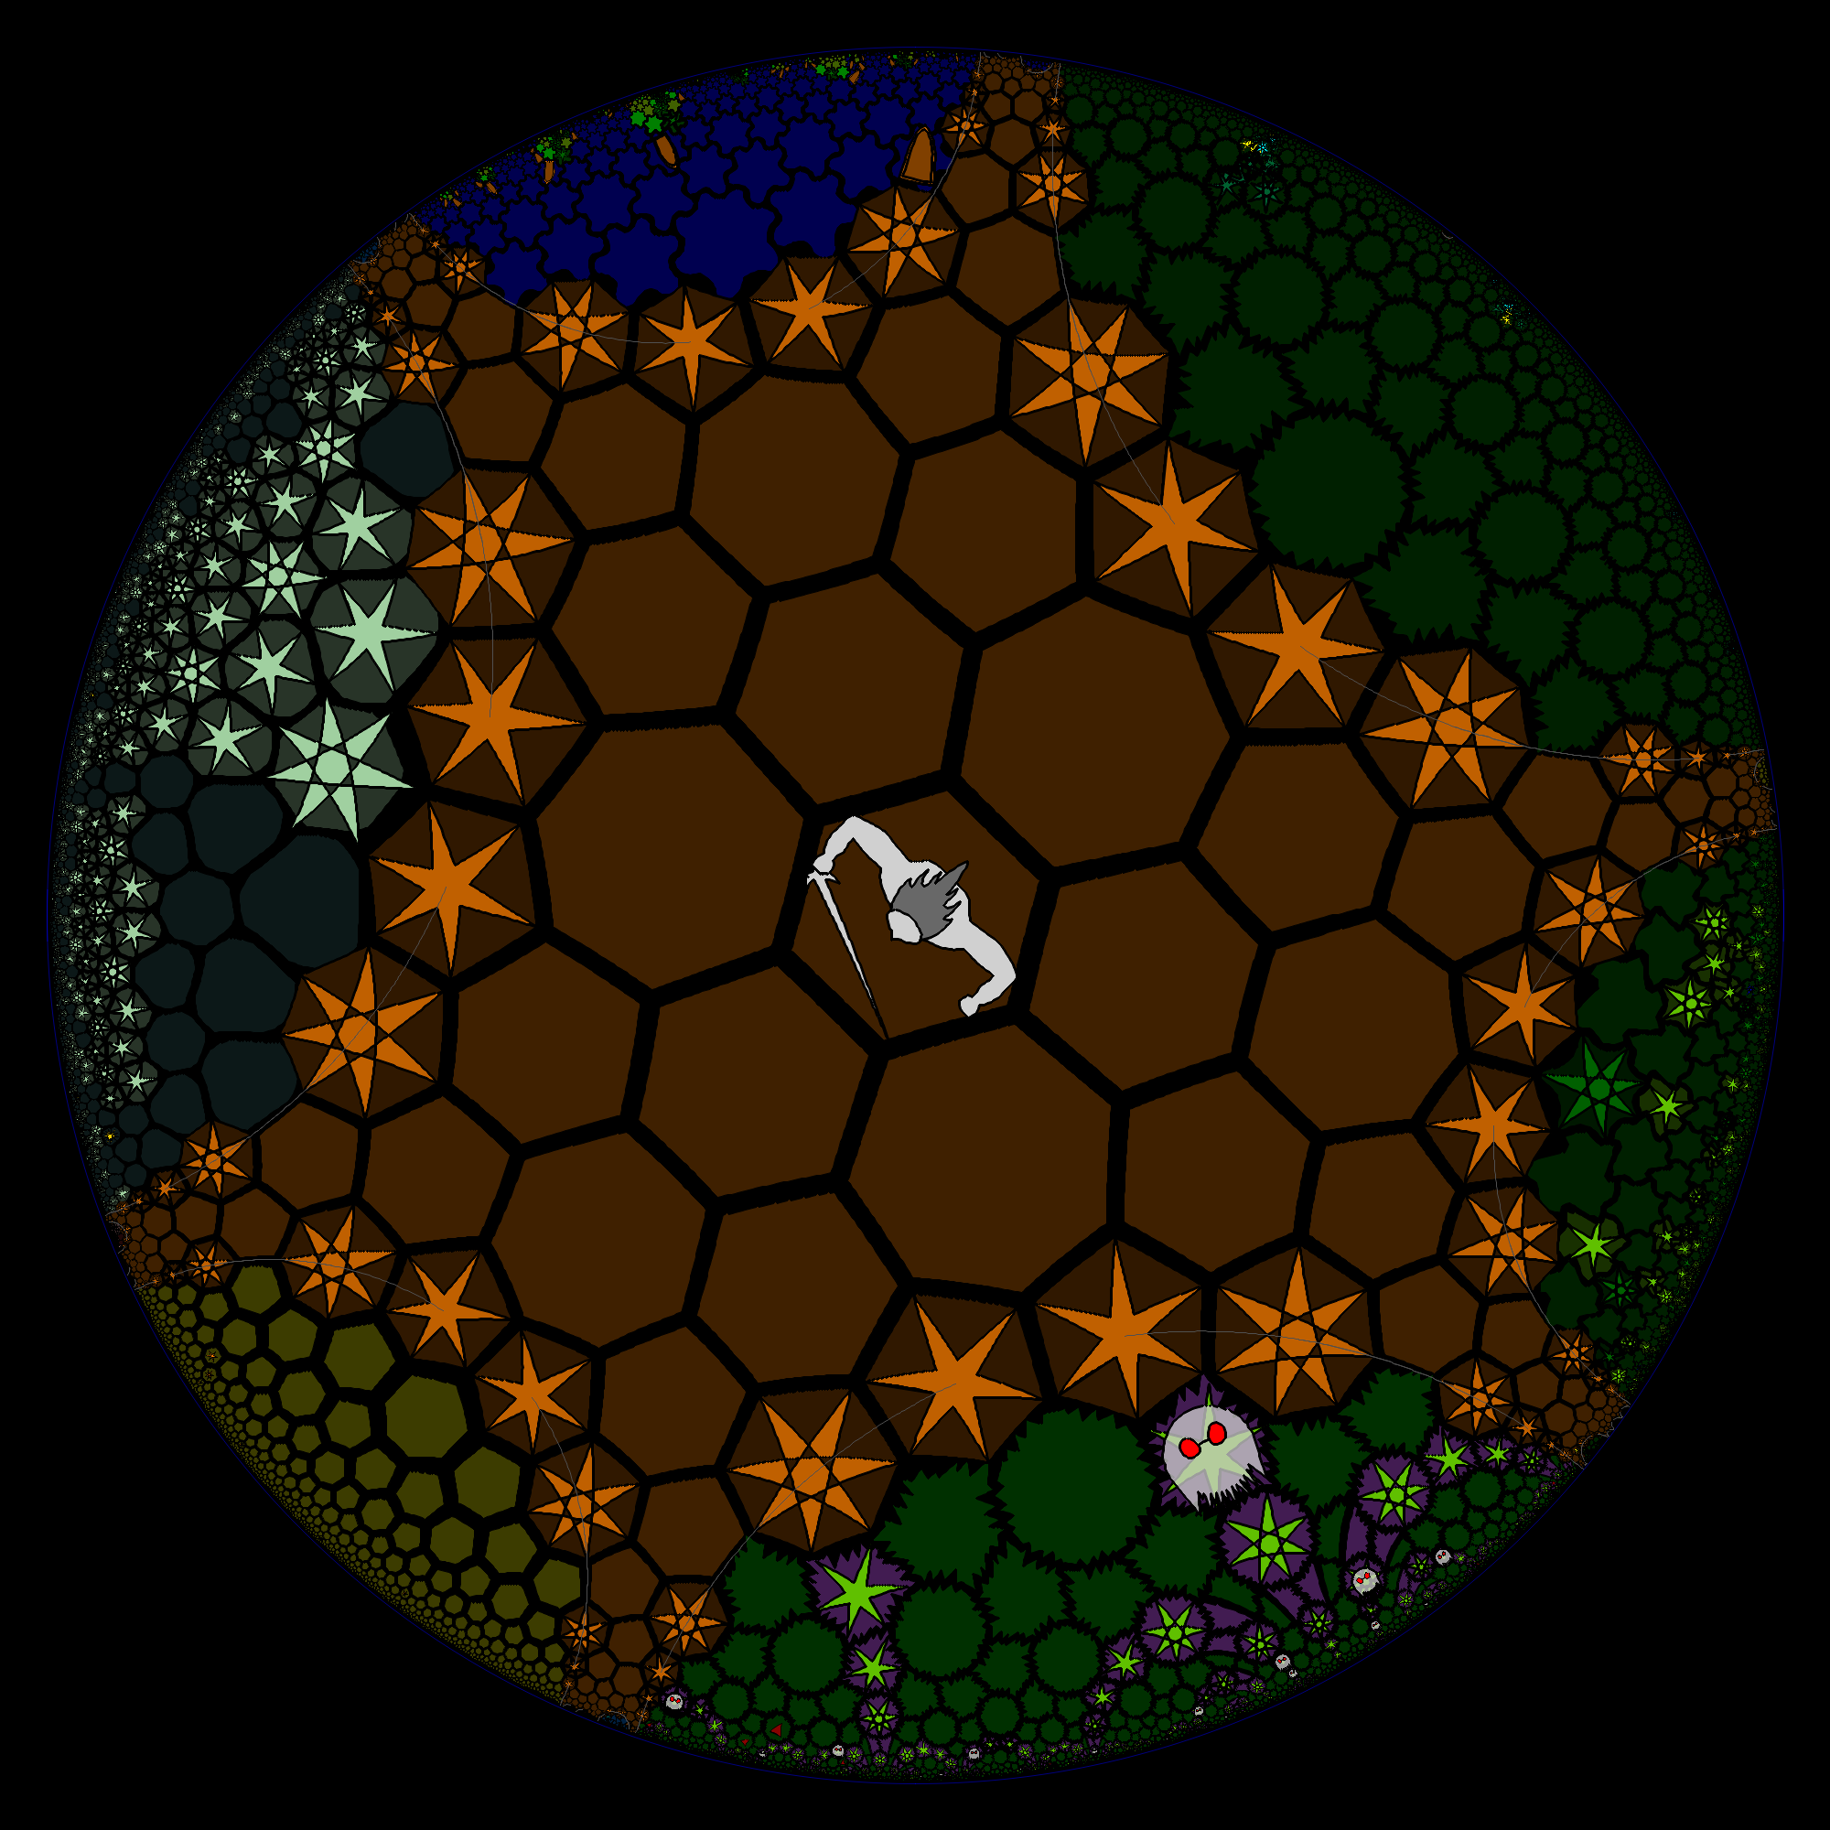
Related Products
HyperRogue
Turn-based world in hyperbolic geometry
Made for research purposes
Hyperbolica
Open world game
Puzzles, games, and quests
Unity
Popular game engine
Only has euclidean based geometry
Figure 14: HyperRogue render with projection warping.
| Project Plan
| Lights Out
| Non-Euclidean Game
FACULTY PRESENTATION | 12
Notes:
Lincoln

Slide 13
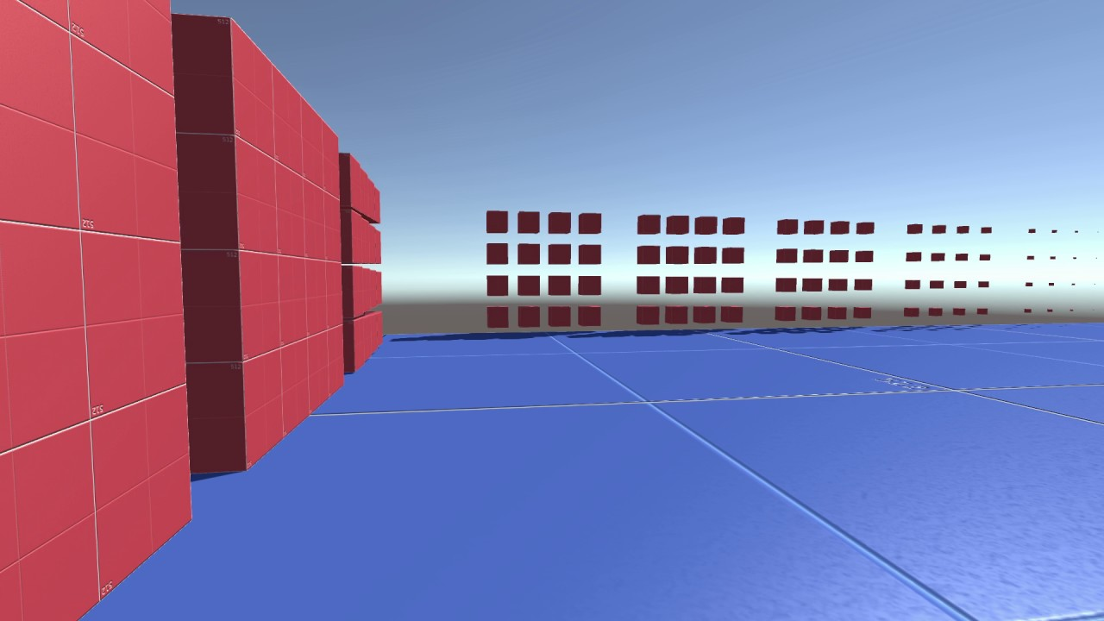
Market Gap
Many existing Non-Euclidean elements are made using smoke and mirrors instead of hosting a fundamentally Non-Euclidean geometry
Mainstream engines don’t support Non-Euclidean geometries
Non-Euclidean based games have not breached mainstream interest for video games
Figure 15: An example of “fake” Non-Euclidean development.
| Project Plan
| Lights Out
| Non-Euclidean Game
FACULTY PRESENTATION | 13
Notes:
Lincoln

Slide 14
Potential Risks & Mitigations
Complexity of pure Non-Euclidean rendering
Optimize conversion calculations, intelligently choose conversion targets
Game won’t integrate well in engine
Communicate closely and integrate necessary features for support
Timeline Issues
Become aware of timeline as soon as possible for blocking issues
Work as a team to solve blocking issues, add crunch time to schedules
Gameplay is not enjoyable
Iterating on versions through prototyping can identify and alleviate gameplay issues
| Project Plan
| Lights Out
| Non-Euclidean Game
FACULTY PRESENTATION | 14
Notes:
Lincoln

Slide 15
Task | Person Hours
Product Research | 200
Game Design Creation | 85
Prototyping Game Design | 100
Integrating Game Prototypes | 200
Creating Demo | 150
Learning Rendering | 80
Render Basic Features | 100
Rendering Complex Features | 150
Integrating Rendering Features | 200
Resource Estimation
Resources Needed
Sprites/Images
Version Control
Game Lab Access
Rendering Libraries
Physical Hardware
| Project Plan
| Lights Out
| Non-Euclidean Game
FACULTY PRESENTATION | 15
Notes:
Zach

Slide 16
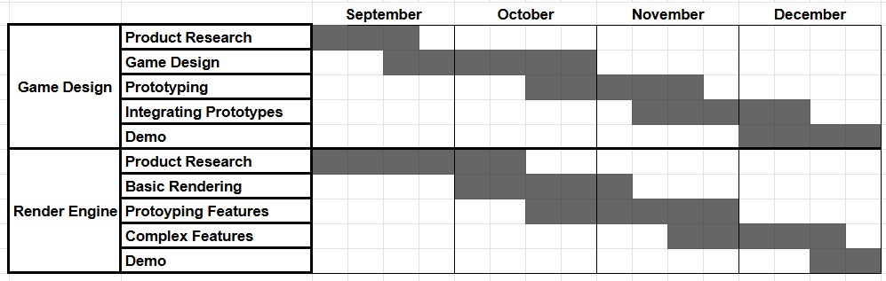
Project Schedule
Waterfall-style task decomposition and schedule
Tasks completed via Agile methods
| Project Plan
| Lights Out
| Non-Euclidean Game
Figure 16: Planned development schedule by phase and month.
FACULTY PRESENTATION | 16
Notes:
Zach

Slide 17
System Design
| sdmay25-37

Slide 18
Task Decomposition
Lights Out Non-Euclidean Game
Lights Out Non-Euclidean Game
Game Design Development
Engine Development
Game Design Development
Engine Development
Abstractions
Abstractions
Hyperbolic Shaders
Hyperbolic Shaders
Entity-Component System
Entity-Component System
Prototyping
Prototyping
Specify Requirements
Specify Requirements
Game Mechanics
Player Interaction
Game Mechanics
Input Management
Player Interaction
Input Management
High-Level Story
Testing
High-Level Story
Camera Controls
Testing
Camera Controls
| System Design
| Lights Out
| Non-Euclidean Game
| System Design
| Lights Out
| Non-Euclidean Game
| System Design
| Lights Out
| Non-Euclidean Game
FACULTY PRESENTATION | 18
Notes:
Zach

Slide 19
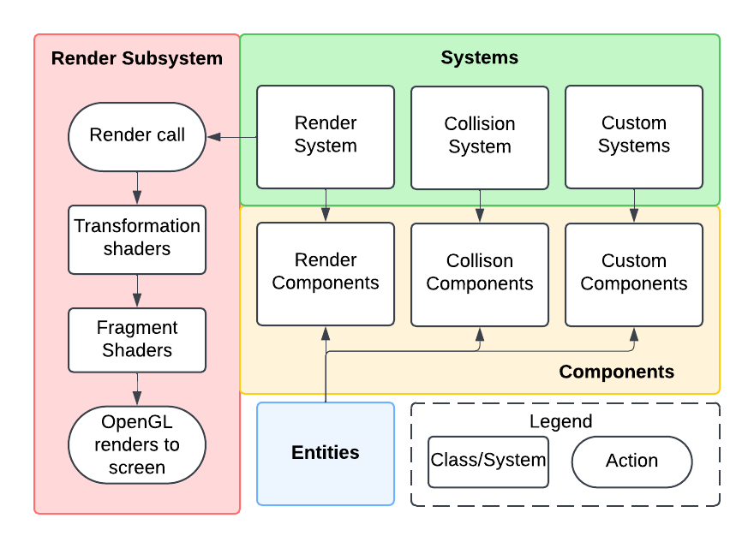
Detailed Design
| System Design
| Lights Out
| Non-Euclidean Game
| System Design
| Lights Out
| Non-Euclidean Game
FACULTY PRESENTATION | 19
Notes:
Ben

Slide 20
Technology Platforms
Technology | Pros | Cons
OpenGL | State of the Art Fast Learning Language Cross Platform | Performance variability between platforms
Unity | State of the Art “Free” to use Generic use Documentation/Resources | Non-customizable engine Poor task-specific optimization
Github | Version Control Task Allocation | Limited file size Difficulty with Unity
Personal Laptop | Ease of Use Easy to Transport Easy to Test | Limited computing resources
| System Design
| Lights Out
| Non-Euclidean Game
FACULTY PRESENTATION | 20
Notes:
Spencer

Slide 21
Test Plan
Plan
Create initial prototypes of mechanics
Test individually
Integrate with other functional units (game and engine)
Test Integration
Tools to Use:
Google Testing Suite (GTest and gMock)
CTest (built-in CMake testing framework)
Profilers (Valgrind, Visual Studio, Unity Profiler)
Unity Testing Framework
| System Design
| Lights Out
| Non-Euclidean Game
FACULTY PRESENTATION | 21
Notes:
Spencer

Slide 22
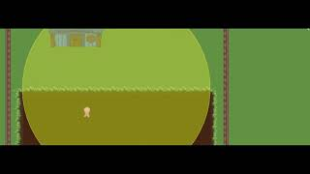
Prototype Implementations - Game Design
Purpose:
Outline the basic
game mechanics
Determine engine
requirements for final
implementation
Outcomes:
Developed design elements
Main gameplay elements created to be developed in engine
A basic outline of home scene and farmer mechanics.
| System Design
| Lights Out
| Non-Euclidean Game
FACULTY PRESENTATION | 22
Notes:
Spencer

Slide 23
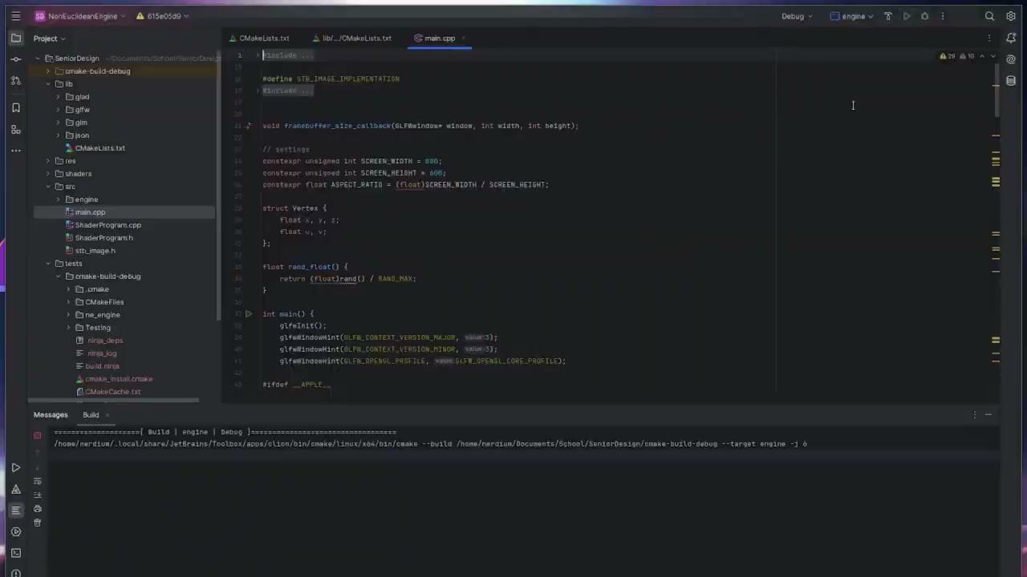
Prototype Implementations - Render Engine
Purpose:
Begin outlining engine
development
Find blocking issues
early in development
to focus on issues
Outcomes:
Template of rendering engine
Basic rendering loop to abstract and improve
The basic features implemented for the rendering loop.
| System Design
| Lights Out
| Non-Euclidean Game
FACULTY PRESENTATION | 23
Notes:
Ben

Slide 24
Conclusion
| sdmay25-37

Slide 25
Current Project Status
Game Design
  Created Design Documents
  Core Gameplay Prototype Finished
  Functional Demo
Render Engine
  Engine build/testing framework created with CMake
  Simplified Entity-Component-System functionality that needs heavy optimization
  Able to perform a stereographic projection from a hyperbolic surface. Working on creating a tiling/mesh for the surface
  Input Management and Camera Abstractions are in testing phase to ensure proper functionality
| Conclusion
| Lights Out
| Non-Euclidean Game
FACULTY PRESENTATION | 25
Notes:
Spencer - Game Design Part
Ben - Render Engine part

Slide 26
Task Responsibilities and Contributions
Member | Responsibilities | Contributions
Tasman Grinnell | Project Manager Render Engineer | Input Management, Collision Detection, General Project Management
Ben Johnson | Render Engineer System Lead | Engine Architecture Design and Implementation, Performance Analysis, and Optimization
Josh Deaton | Render Engineer Lead | Engine toolchain customization and design, Non-Euclidean projections
Cory Roth | Game Designer Notes Writer | Lead Design Document Writing, Light Mechanic, Handled Notes for Meetings
Zach Rapoza | Game Designer Art Lead | Development of Farmer and its interactions, Menus
Spencer Thiele | Game Design Lead Prototyping Lead | Directing Game Design and Development, Prototyping Game Elements
Lincoln Kness | Game Designer Website Manager | Creating and Testing Mechanics in Unity, Updating the Website
| Conclusion
| Lights Out
| Non-Euclidean Game
FACULTY PRESENTATION | 26
Notes:
Cory

Slide 27
Future Plans
Render Non-Euclidean math
Finish prototyping game mechanics
Integrate base game in render engine
Continue to implement auxiliary features to polish the game
Create API for render engine
| Conclusion
| Lights Out
| Non-Euclidean Game
FACULTY PRESENTATION | 27
Notes:
Cory

Slide 28
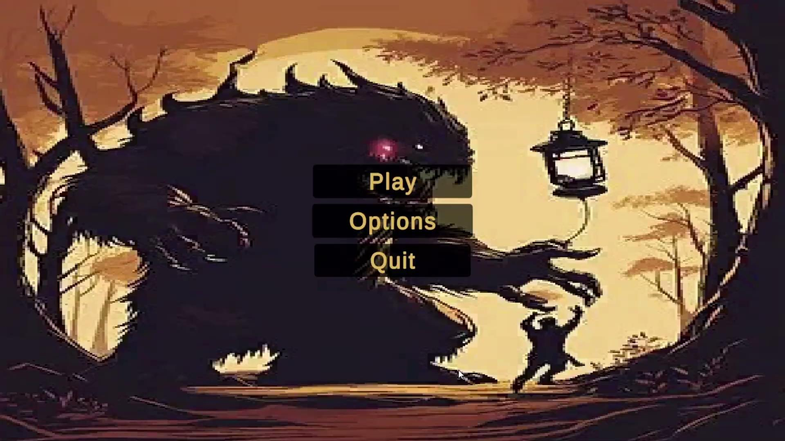
Game Design Demo
| Conclusion
| Lights Out
| Non-Euclidean Game
FACULTY PRESENTATION | 28

Slide 29
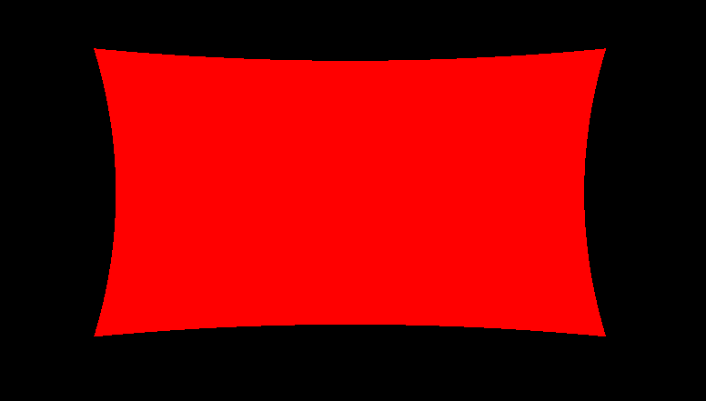
Render Engine Demo
| Conclusion
| Lights Out
| Non-Euclidean Game
FACULTY PRESENTATION | 29
Notes:
Josh - Shader Demo + explanation + challenges

Slide 30
Questions?
| sdmay25-37

Slide 31
Appendix
| sdmay25-37

Slide 32
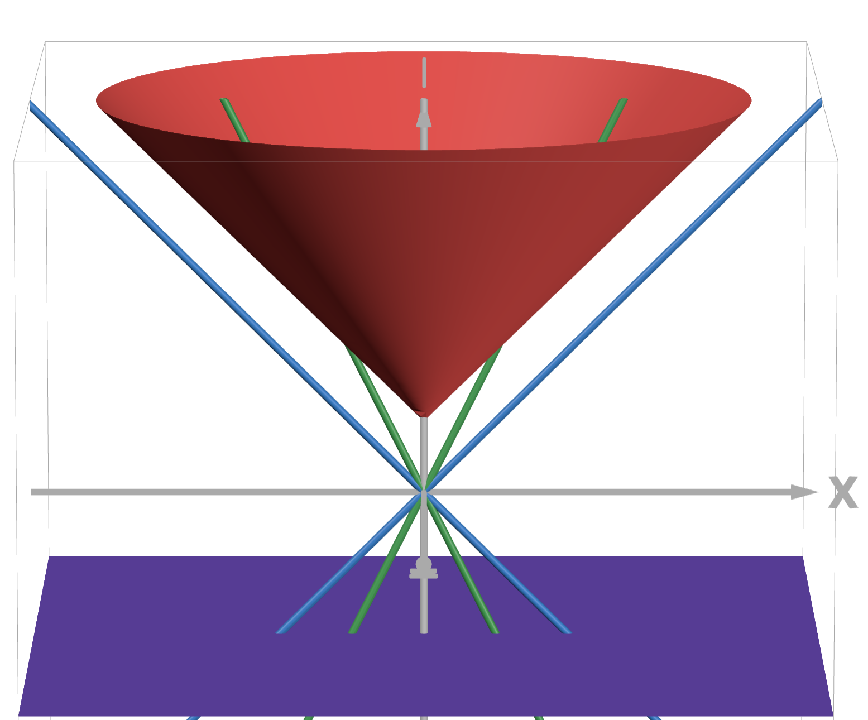
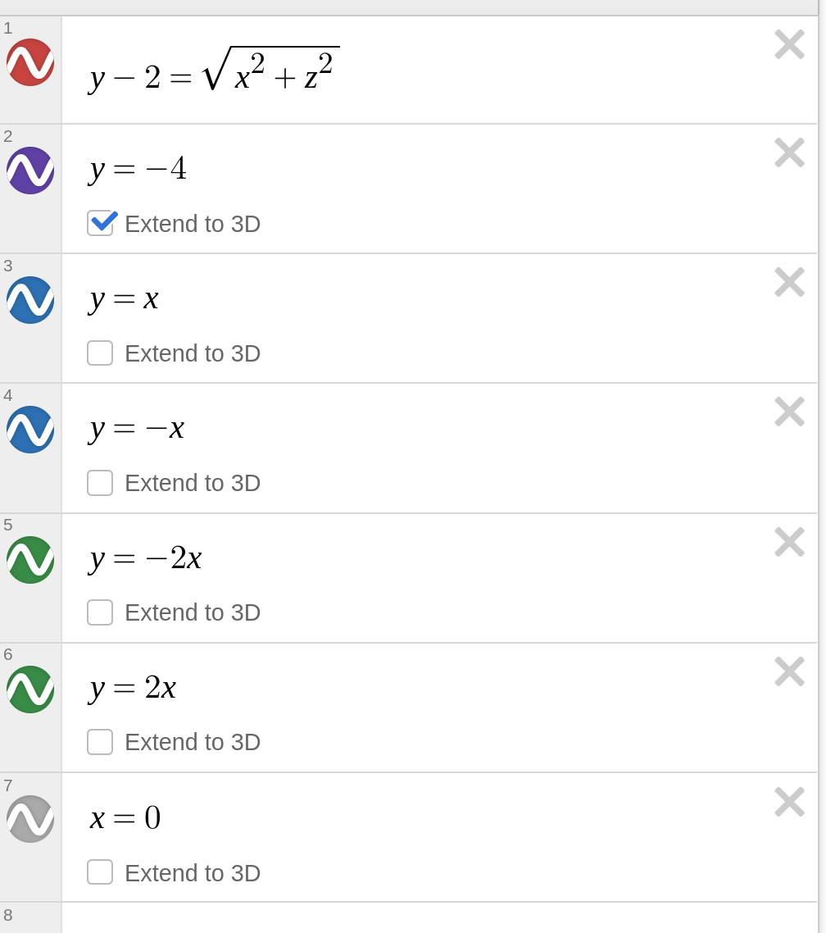
More Non-Euclidean Geometry
Example demonstrating singularity at the edges
| System Design
| Lights Out
| Non-Euclidean Game
FACULTY PRESENTATION | A
Notes:
Zach

Slide 33
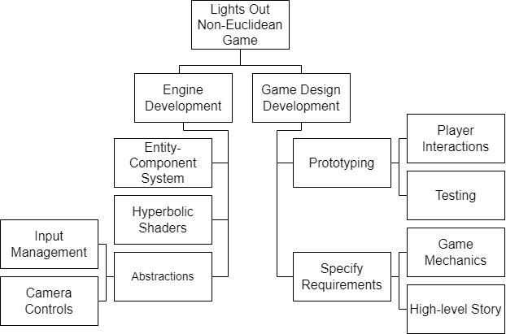
Task Decomposition
Game Design
Specify Requirements
Create Prototypes
Rendering Engine
Support Game Design Requirements
Host Projection Calculations (Hyperbolic Shaders)
Create Memory and Entity Management Systems
Abstract Rendering loop
| System Design
| Lights Out
| Non-Euclidean Game
FACULTY PRESENTATION | B
Notes:
Zach

Slide 34
Task Decomposition
Game Design
Specify Requirements
Create Prototypes
Rendering Engine
Support Game Design Requirements
Host Projection Calculations (Hyperbolic Shaders)
Create Memory and Entity Management Systems
Abstract Rendering loop
| System Design
| Lights Out
| Non-Euclidean Game
FACULTY PRESENTATION | C
Notes:
Zach

Slide 35
Project Deliverables
The final deliverables are:
A working game/rendering engine featuring Non-Euclidean Geometry
A finished and polished videogame matching:
  Design Requirements
  Functional Requirements
| Lights Out
| Non-Euclidean Game
FACULTY PRESENTATION | D
Notes:
Tasman

Slide 36
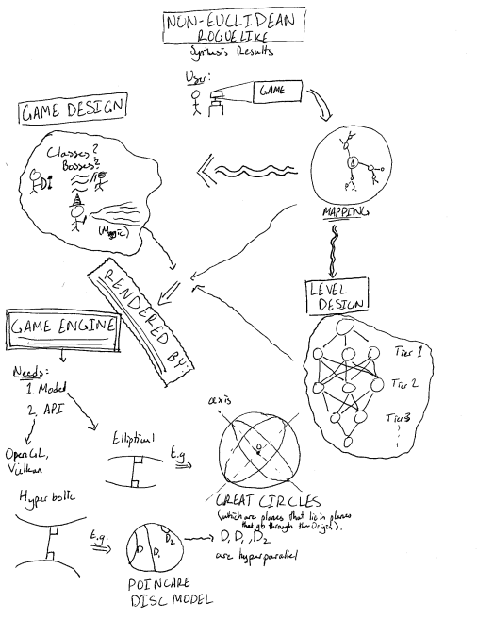
Conceptual Sketch
| Lights Out
| Non-Euclidean Game
FACULTY PRESENTATION | E

Slide 37
Technical/Other Constraints/Considerations
Timeline
  Only 2 Semesters
Budget
External Use of Engine
| Lights Out
| Non-Euclidean Game
FACULTY PRESENTATION | F

Slide 38
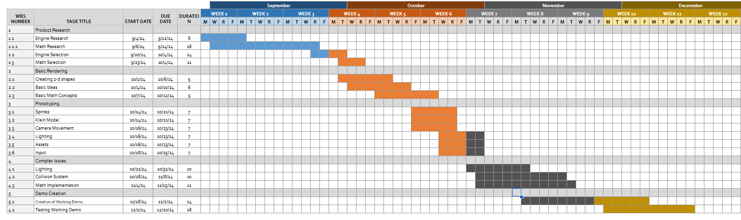
Project Schedule - Render Engine
| Lights Out
| Non-Euclidean Game
FACULTY PRESENTATION | G

Slide 39
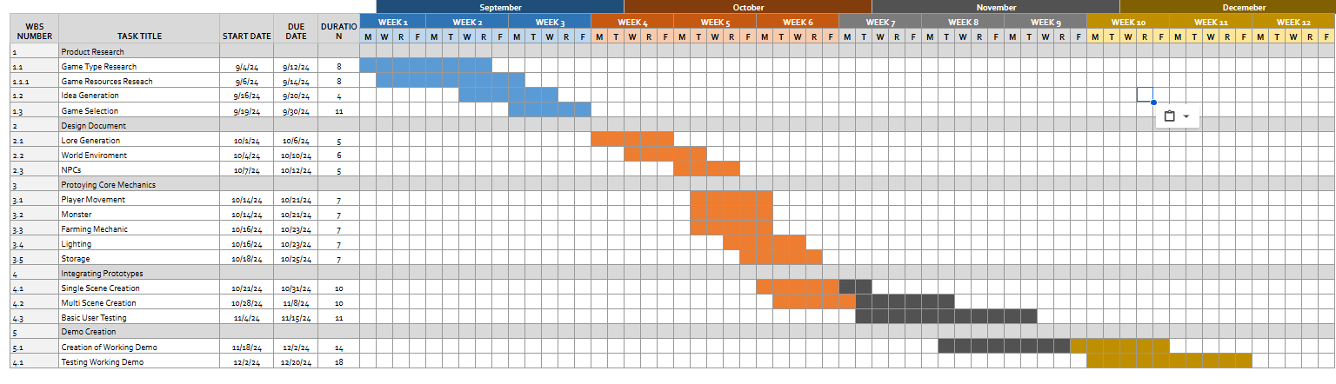
Project Schedule - Game Design
| Lights Out
| Non-Euclidean Game
FACULTY PRESENTATION | H

Slide 40
Task Decomposition
Lights Out Non-Euclidean Game
Engine Development
Game Design Development
Abstractions
Hyperbolic Shaders
Entity-Component System
Prototyping
Specify Requirements
Input Management
Player Interaction
Game Mechanics
Camera Controls
Testing
High-Level Story
| System Design
| Lights Out
| Non-Euclidean Game
FACULTY PRESENTATION | I
Notes:
Zach

Slide 41
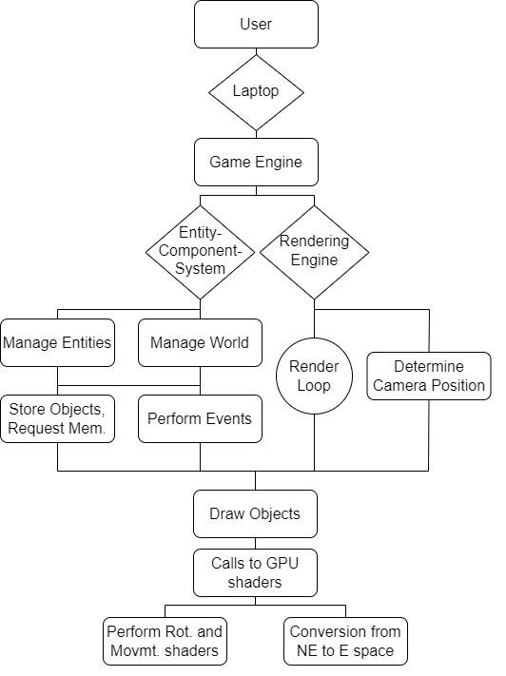
Detailed Design
Game Engine
Receives and handles user input and
directs to the appropriate system
Updates frames based on rendering engine
Rendering Engine
Handle drawing operations for entities
and world
Entity Component System (ECS)
Manages memory allocation
Laptop
Main I/O device
Sends user input to the game engine
| System Design
| Lights Out
| Non-Euclidean Game
| System Design
| Lights Out
| Non-Euclidean Game
FACULTY PRESENTATION | J
Notes:
Ben

Slide 42
Task Decomposition
Lights Out Non-Euclidean Game
Engine Development
Game Design Development
Abstractions
Hyperbolic Shaders
Entity-Component System
Prototyping
Specify Requirements
Input Management
Player Interaction
Game Mechanics
Camera Controls
Testing
High-Level Story
| System Design
| Lights Out
| Non-Euclidean Game
FACULTY PRESENTATION | K
Notes:
Zach

Slide 43
Task Decomposition
Lights Out Non-Euclidean Game
Lights Out Non-Euclidean Game
Game Design Development
Engine Development
Game Design Development
Engine Development
Abstractions
Abstractions
Hyperbolic Shaders
Hyperbolic Shaders
Entity-Component System
Entity-Component System
Prototyping
Prototyping
Specify Requirements
Specify Requirements
Game Mechanics
Player Interaction
Game Mechanics
Input Management
Player Interaction
Input Management
High-Level Story
Testing
High-Level Story
Camera Controls
Testing
Camera Controls
| System Design
| Lights Out
| Non-Euclidean Game
FACULTY PRESENTATION | L
Notes:
Zach

Slide 44
Task Decomposition
Game Design
Specify Requirements
Create Prototypes
Rendering Engine
Support Game Design Requirements
Host Projection Calculations (Hyperbolic Shaders)
Create Memory and Entity Management Systems
Abstract Rendering loop
| System Design
| Lights Out
| Non-Euclidean Game
FACULTY PRESENTATION | M
Notes:
Zach

Slide 45
Future Plans
Render Non-Euclidean math
Finish prototyping game mechanics
Integrate base game in render engine
Continue to implement auxiliary features to polish the game
Create API for render engine
| Conclusion
| Lights Out
| Non-Euclidean Game
FACULTY PRESENTATION | N
Notes:
Cory

Slide 46
Detailed Design
Game Engine
Receives and handles user input and
directs to the appropriate system
Updates frames based on rendering engine
Rendering Engine
Handle drawing operations for entities
and world
Entity Component System (ECS)
Manages memory allocation
Laptop
Main I/O device
Sends user input to the game engine
Render Components
Render Components
Render Components
Render Components
Render Components
Render Components
Render Components
| System Design
| Lights Out
| Non-Euclidean Game
| System Design
| Lights Out
| Non-Euclidean Game
FACULTY PRESENTATION | N
Notes:
Ben

Slide 47







Project Members
Tasman Grinnell
Project Manager
Rendering Engineer
Josh Deaton
Rendering Engine Lead
Lincoln Kness
Game Design Lead
Web Developer
Ben Johnson
Rendering Engineer
Systems Lead
Zach Rapoza
Game Design Engineer
Spencer Thiele
Game Design Engineer
Cory Roth
Rendering and Game Design Engineer
| sdmay25-37

